Slide 1
Collecting SIFs from FEA
Topics:
Define the SIF
i) Basic Use
ii) Basic Development and Tests
Example of a SIF useage
SIF nuances
Differences between FEA modeling and manufacturered fittngs
Different types of FEA Models
Approaches to predicting SIFs from FEA models
How more applicable SIF data works in CAESAR II

Slide 2
Why Worry about SIFs? One reason is that current i-factor equations are simple and quite old.
LR Bend radius bend R ~ 3r₂
h = (T)(3) / r₂

Slide 3
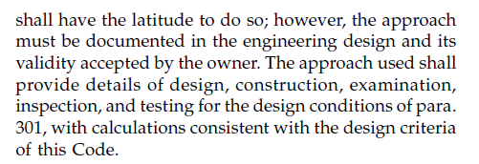
More applicable data:
1)FEA ?
2)ASME ST-LLC 07-02
3)ASME Section III Subsection NB
4)Test
5)Other methods that can satisfy intent of the code.
“Consistent with the design criteria of this Code.”

Slide 4
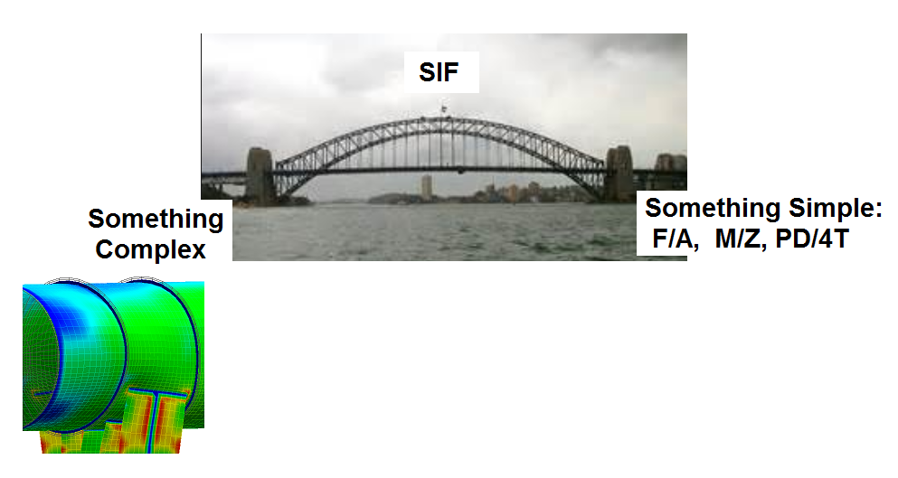
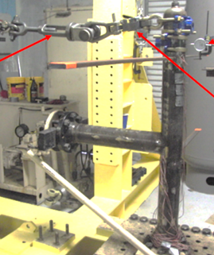
The SIF is really a bridge, that lets the stress analyst get from something simple, to something complex. For the stress analyst, something simple is M/Z, and something complex is the stress in a tee piece.

Slide 5
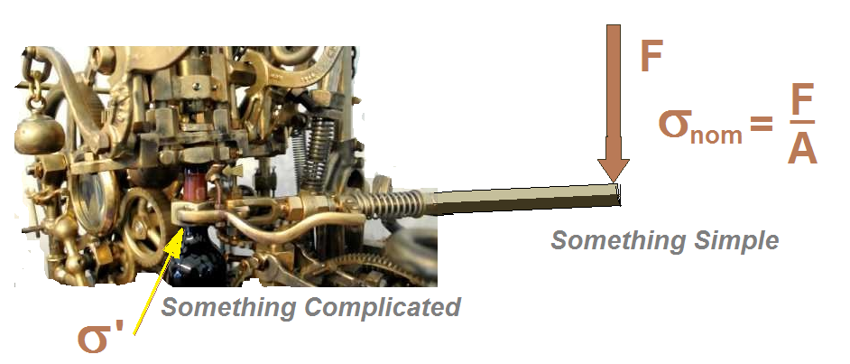
The General Idea/Equation:
SIF = stress intensification factor
S’ = The stress we’re interested in. (Stress in the “complex” component.)
Snom= A stress that’s easy to calculate.
σ ’ = SIF x Snom

Slide 6
SIF is used with respect to stress in a piping system to turn something simple (the nominal stress) into something complicated (the stress to compare to the allowable)
When the geometry that we’re evaluating cannot be easily evaluated, i.e. bends, tees, reducers usually because of their shape we need a factor (SIF/SSI) to get between a simple stress and a failure preducing stress.

Slide 7
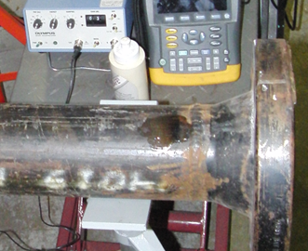
The first complicated geometry common in all pipe was a girth butt weld, and so how was the first SIF developed for this geometry.

Slide 8
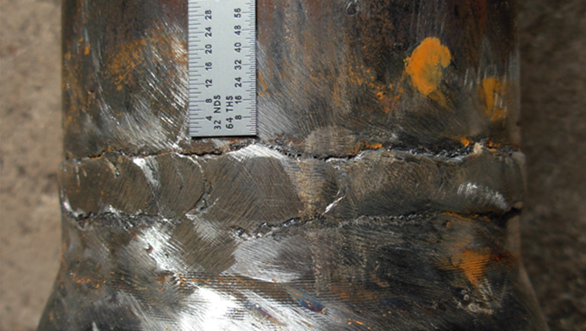
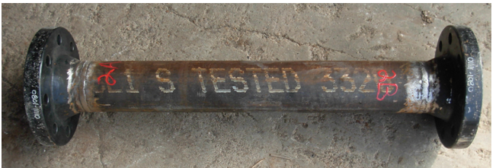

Slide 9
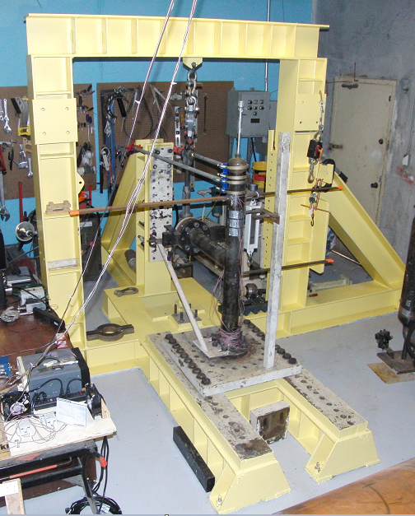
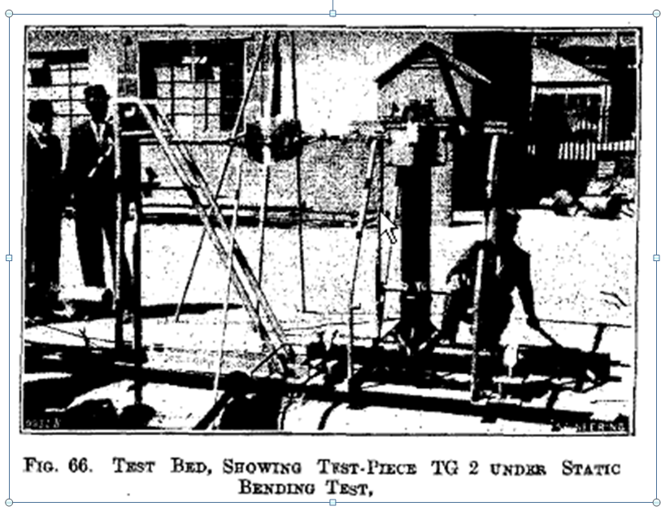
Piping Fatigue Tests from 1935 to 2013
First recorded fatigue tests for piping recorded by Markl. Dynamic shaker tests conducted by Blaire between 1935 to 1945.
PRG k-factor, i-factor and I-factor tests conducted in 2013 – Houston Tx.
Notes:
The rig on the left is the type of test machine that R.W. Schneider and Markl ran, and that Dr. Kahn ran for WRC 329 in the early 1980’s.
The rig on the right is a picture of the first recorded fatigue tests for piping . These tests were run by Blaire in England in 1935 to 1945.
The machine on the right is in the PRG facility in Houston today. We use it to run a variety of tests to support software development and expand results into critical D/T areas.

Slide 10
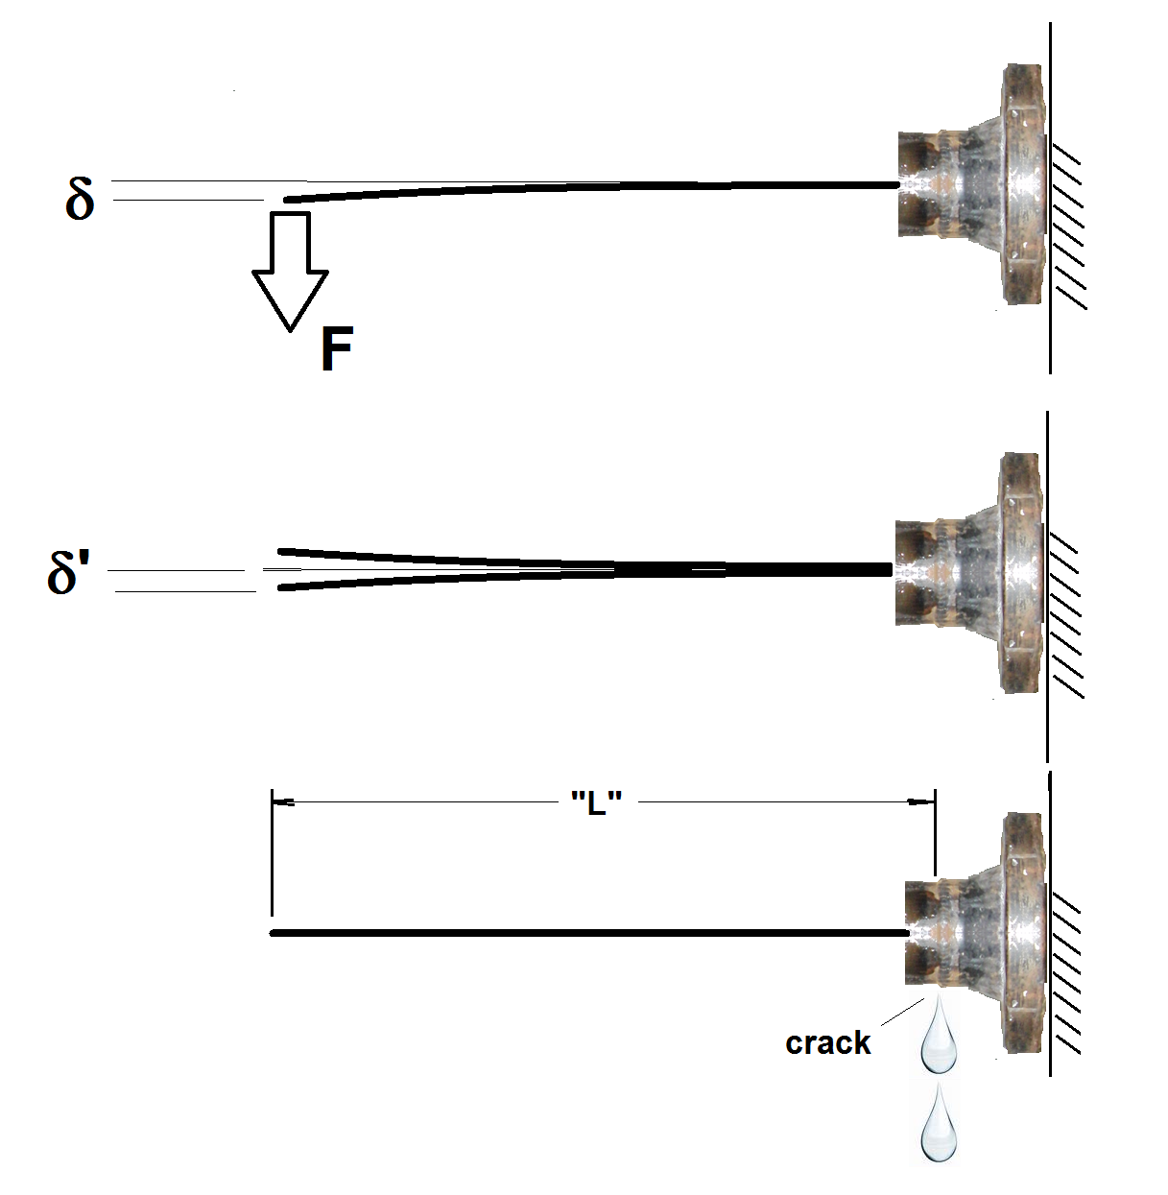

Slide 11
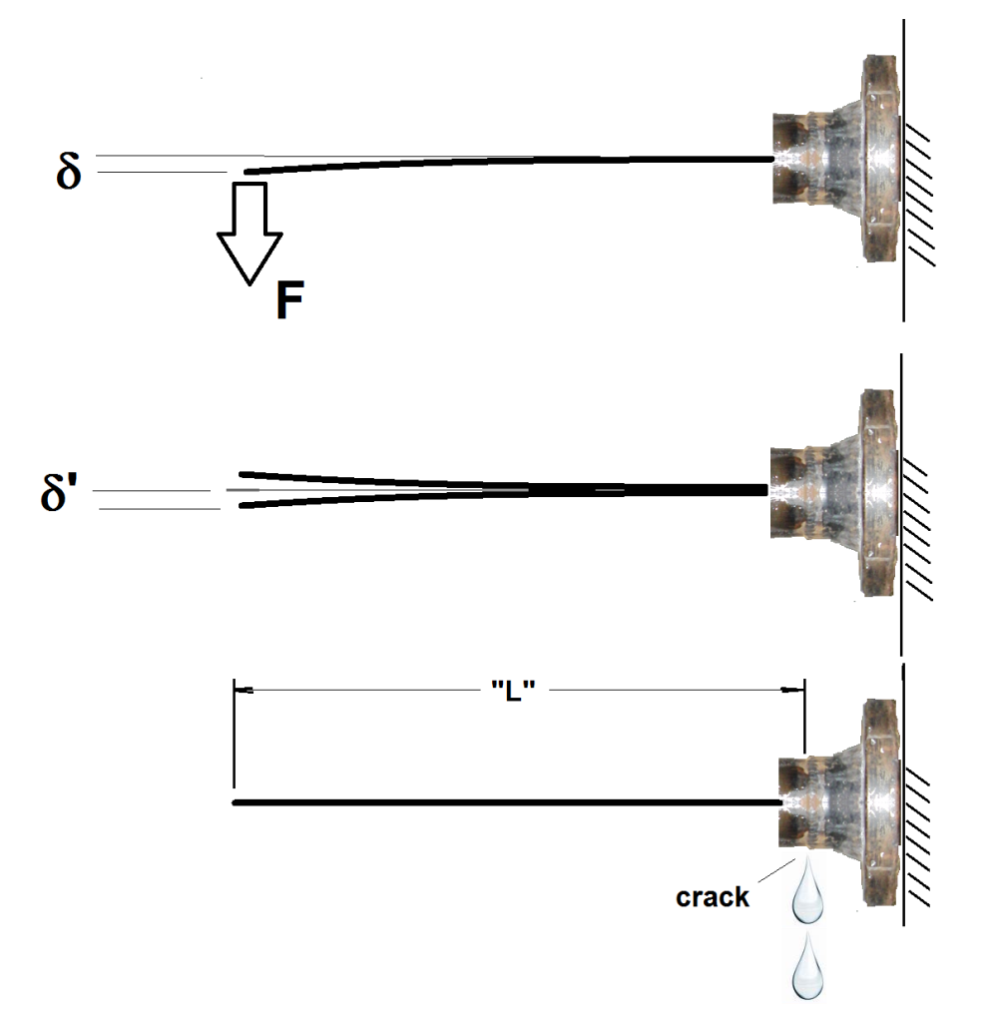
Steps:
1) F and δ are measured to find K = F/δ.
2) Test piece is cycled thru displacement
amplitude of δ’.
3) Leakage occurs at a distance L from the
load and a cycle count “N”.
4) The Moment at the crack location is
computed from M = Kδ’ x L
5) SIF is found from 245,000N^{-0.2}/(M/Z),
where Z = section modulus of pipe.
6) Markl defined SIF = 1. for girth butt weld.
For all other welded components, the moment to produce the crack and leak was lower so the SIF was higher.

Slide 12
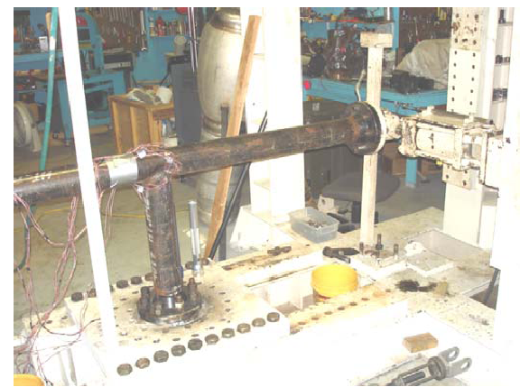

Slide 13
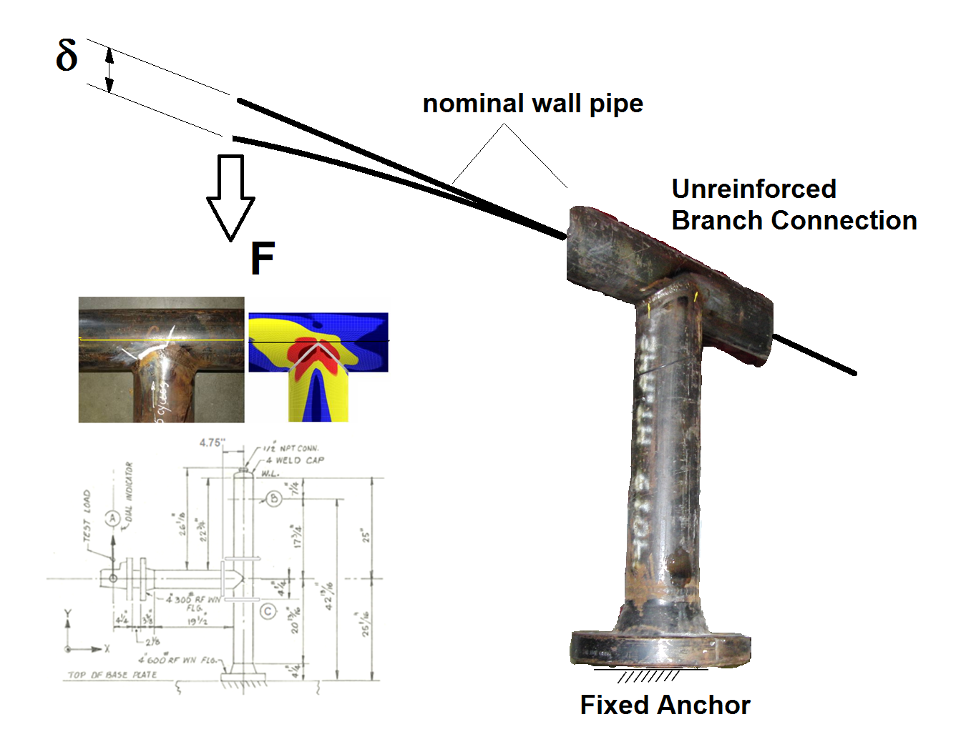

Slide 14
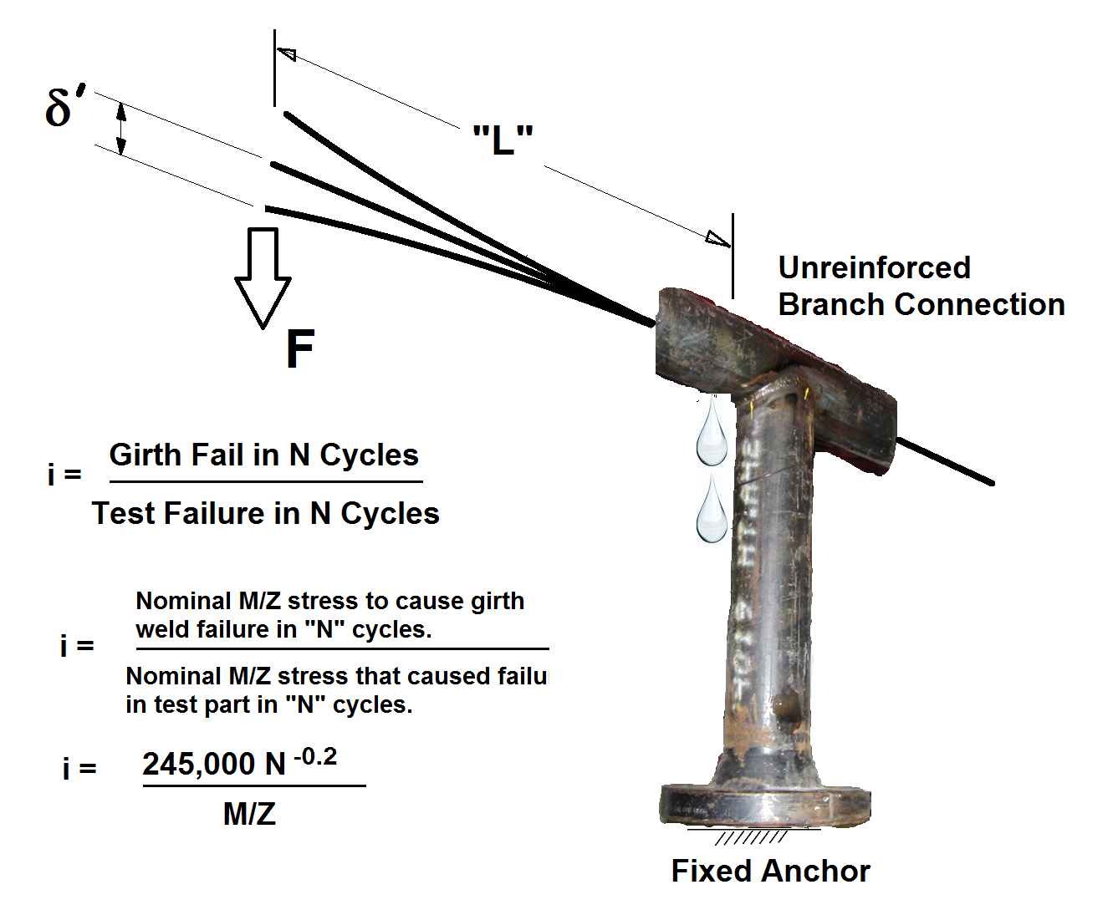

Slide 15
SIFs used in piping are related to failure of a girth butt weld.
Any SIFs we develop using strain gages, finite element analysis , light sensitive plastic models, or stress paint must have a similar basis.

Slide 16
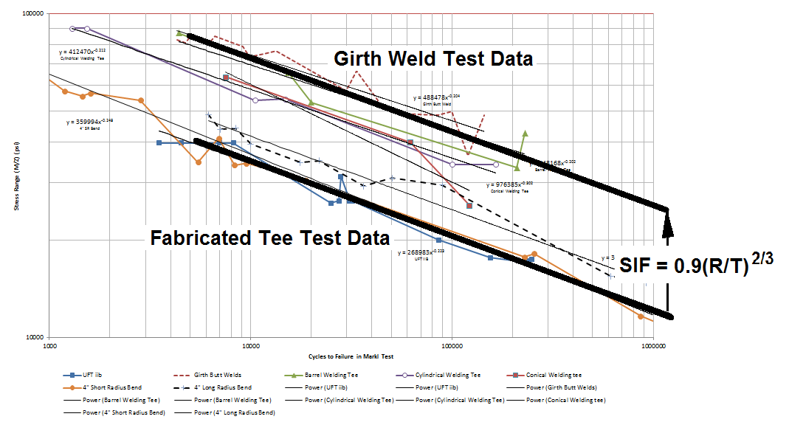
Is the SIF in B31.3 from a test or from an equation?
Notes:
The answer here is both. When you’re calculating a SIF from an FEA analysis you have to make sure you know what it’s going to be used for.

Slide 17
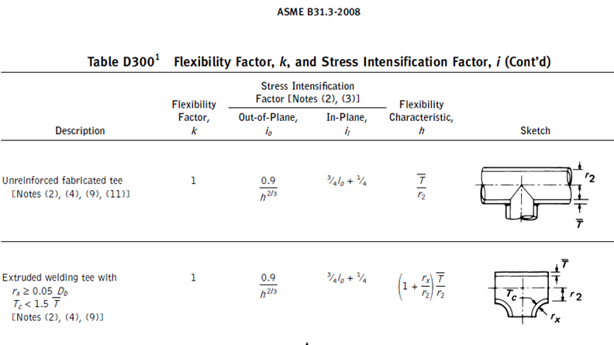
i = 0.9/h^{2/3}; h = T/R; i = 0.9(R/T)^{2/3}

Slide 18
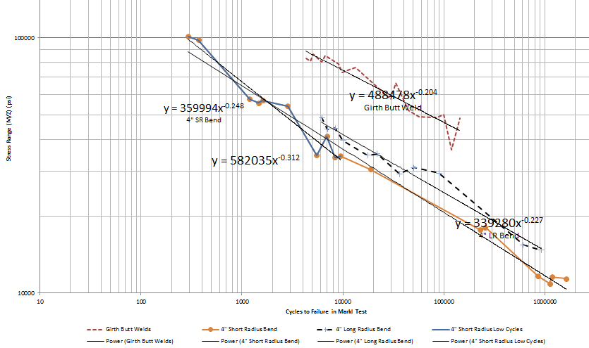
Separation between Girth Butt Welds and Bends

Slide 19
Generally SIF tests are used to predict SIF equations.
SIF tests are for a single component, set of boundary conditions and particular loading
Generally we validate a finite element model with a test SIF, and then use the validated model to predict SIFs for unknown, but similar geometries.

Slide 20
Start Looking at the numbers involved with SIFs:

Slide 21
S’ = Stress Quantity of Interest
Snom = Selected nominal stress
SIF = Stress Intensification Factor
Snom = F/A ; M/Z ; PD/4T
If S’ = Stress of interest due to pressure = SIF_{pressure} x PD/4T
If S’ = Stress of interest due to moments = SIF_{moment} x M/Z
If S’ = Stress of interest due to axial load = SIF_{axial} x F/A

Slide 22
Snom = F/A ; M/Z ; PD/4T
If S’ = Stress of interest due to pressure = SIF_{pressure} x PD/4T
Could Snom be PD/2T instead of PD/4T for the pressure stress?
Any nominal can be selected so long as the stress result on the left side of the equation and the load result on the right side of the equation are proportional as the load increases.
If PD/2T is used instead of PD/4T, the pressure stress of interest doesn’t change and so the accomodating SIF would be half as large, i.e.
SIF_{pressure[PD/2T]} = 0.5 x SIF_{pressure[PD/4T]}

Slide 23
Let’s see how this would work in a real situation that pipe stress engineers might be interested in.

Slide 24
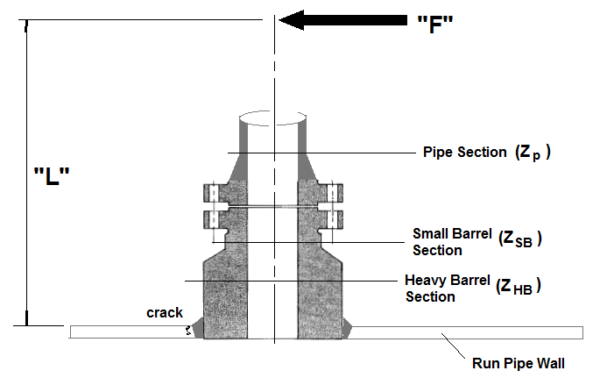
SIF From Test: Apply “F” alternately until water leaks at crack after “N” cycles.
SIF From Test = 245,000N^{-0.2} / (M/Z_{test})
= Stress at Failure in Girth Weld at N Cycles / Stress at Failure in part at N cycles
Z_{test} = Z_{pipe} = Z_{p}
Notes:
This is the standard SIF test approach for an HB fitting.

Slide 25
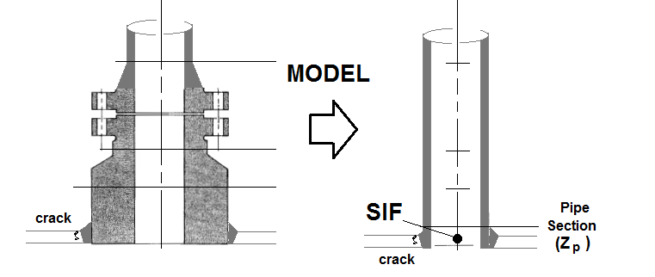
SIF From Test = 245,000N^{-0.2} / (M/Z_{test})
Z_{test} = Z_{pipe} = Z_{p}
The approach described in the SIF test MANDATES the model that will be used.

Slide 26
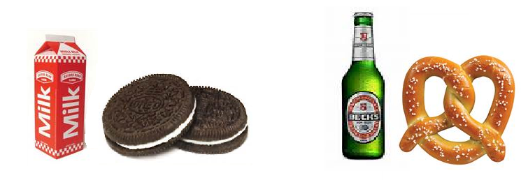
SIFs and nominal stresses are paired.
SIFs are designed for a particular nominal stress.
Because SIFs are not the same doesn’t mean they aren’t correct.
If you develop your own SIF make sure it is used with the correct nominal stress.

Slide 27
What if we want milk with our pretzels?

Slide 28
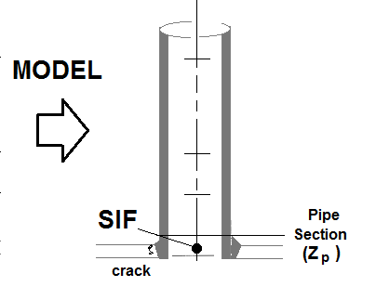
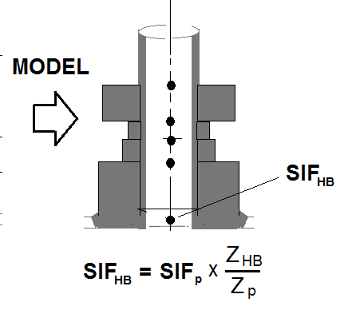
All we have to do is make sure that the resulting stress computed is the same.
Part of what we do as a company when someone asks us to validate a SIF from an unknown origin, is to try to identify the intended nominal stress – which generally becomes trying to figure out what section modulus was intended to be used.
Notes:
SIFp is different than SIFHB – but they are developed for different section modulii in the pipe and when used the correct way result in the same stress calculation.

Slide 29
Key:
1) Use any reasonable nominal stress when you develop a SIF, but
2) The SIF is based on the nominal – the two go together and both must be identified to the end user.
What could go wrong with our nozzle example?

Slide 30
SIF From Test: Apply “F” alternately until water leaks at crack after “N” cycles.
SIF From Test = 245,000N^{-0.2} / (M/Z_{test})
= Stress at Failure in Girth Weld at N Cycles / Stress at Failure in part at N cycles
Z_{test} = Z_{barrel} = Z_{b}
If this SIF is used with pipe it would be way too high. In fact, too high by the ratio of Z_{barrel}/Z_{pipe} or very roughly by the T_{barrel} / T_{pipe}.
Notes:
This is the standard SIF test approach for an HB fitting.

Slide 31
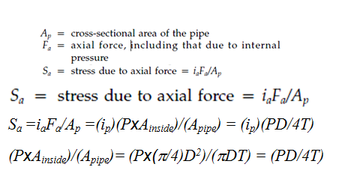
When Dealing with SIFs be Sure to Get the Nominal Basis Correct
The pressure stress at the intersection should be the same regardless of the i-factor or nominal stress basis.
NozzlePRO VIII-2 PCLGold(branch) PCLGold(run)
3.232 (PD/2T) = 3.3 (PD/2T) = 8.404 (Pd/4t) = 6.581 (PD/4T)
58.715 59.95 59.77 59.77
VIII-2 Annex 5.D ip = 3.3 Nominal Stress Basis = PD/2T
NozzlePRO ip = 3.232 Nominal Stress Basis = PD/2T
PCL-Gold (Branch) ip = 8.404 Nominal Stress Basis = Pd/4t
PCL-Gold (Run) ip = 6.581 Nominal Stress Basis = PD/4T
Why use Pd/4t instead of Pd/2t or PD/2T?
Notes:
There are three different i-factors for a 10x14 intersection. One is always used with the run pipe D/2T, (VIII-2 and NozzlePRO)
One is used with the branch pipe d/4t, and
One is is used with the run pipe D/4T.
For this intersection these methods agree, as we would hope.
Does it matter whether we use PD/4t or PD/2t? No we can use any nominal we want as long as we’re consistent. To use B31.3 App P we need to use the branch and run PD/4t, and for VIII-2 and NozzlePRO we need to use PD/2T for the run pipe.

Slide 32
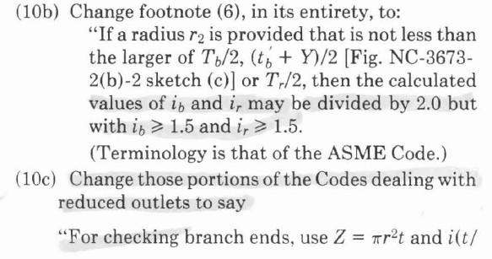
Basically – don’t use the effective section modulus with the new rules. It is easier for the rules to provide a more appropriate i-factor.. BE CAREFUL IF YOUR PIPE STRESS PROGRAM USES EFFECTIVE SECTION MODULUS for SIFs THAT YOU ENTER!!! (see next slides)
AND – Fix Weldon Fittings (Olets)

Slide 33
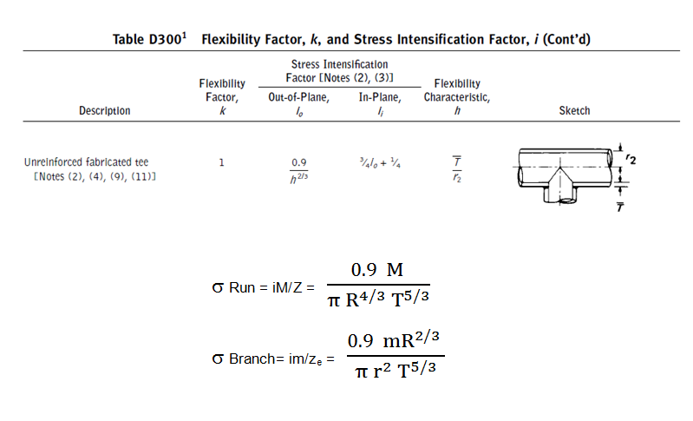
Notes:
The run stress is a function of the run pipe dimensions only. The branch stress has r, R and T – but no t. Similar to assumptions in WRC 107

Slide 34
Eqn. used for B31 stress at UFT reduced branch connections;
stress = I M/Z x (t/T)
Notes:
The run stress is a function of the run pipe dimensions only. The branch stress has r, R and T – but no t. Similar to assumptions in WRC 107

Slide 35
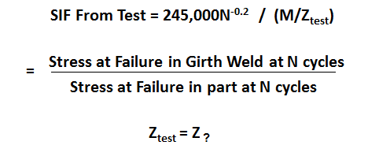
The often million dollar question, is “How do we get from the test equation below, to a finite element based equation?”
Nominal
Nominal

Slide 36
The often million dollar question, is “How do we get from the test equation below, to a finite element based equation?”

Slide 37
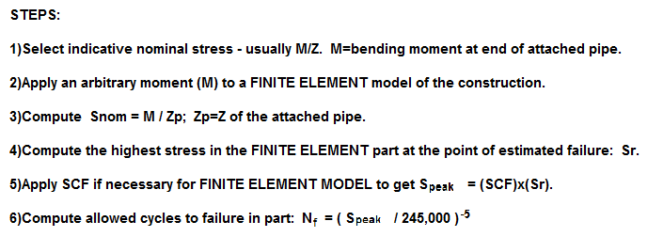

Slide 38
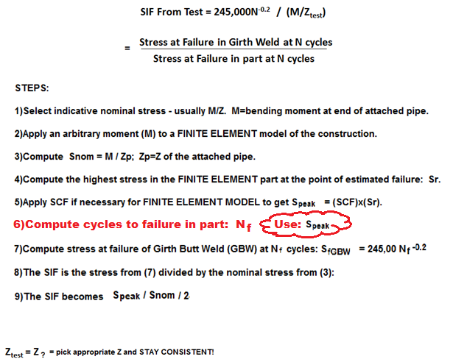

Slide 39
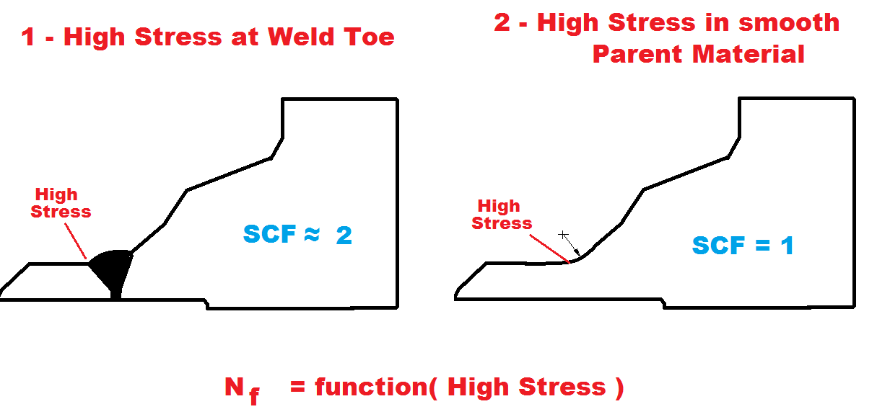

Slide 40
Key Mean Stress to Failure Equations (psi, range)
PRG/Hinnant (welds) 1,895,000 N^{-0.3353}
;nominal M/Z stress range to failure (girth weld)
Markl (welds): 490,000 N^{-0.2}
;nominal M/Z stress amplitude to failure (girth weld)
ASME Welded Mean: 1,576,317 N^{-0.3195}
;nominal M/Z stress range to failure (VIII-2 Part 5)
;simplifications for all coeffiients. For information only.
Polished Bar: 2(8664N^{-0.5} + 21.6) x 1000
;smoothed bar stress range to failure
N = Cycle to failure
Notes:
Here are three welded approaches and the ASME polished bar curve that can be compared on an apples-to-apples basis for predicting failure – the first three for welded geometries, and the last for smooth surfaces.
These equations are used to: 1-predict cycles if doing a failure study, or to 2-find the degree of separation between design and mean failure prediction. Are we too conservative – or not conservative enough. Results may be interesting in the high’ish cycle ranges > 40,000 cycles or so.

Slide 41
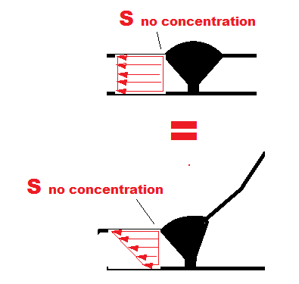

Slide 42
S = 490,000 N ^{-0.2}
(For welds where SCF ~ 2 )
S _{with bending} = S_{without bending}
to predict failure

Slide 43
x2
Pick the right SCF so that the peak stress goes back into the stress-failure relationship equation.
Peak stress at weld is NOT used here
What SCF should go into this equation? The SCF that makes the equation work for the part under study.

Slide 44
i = C₂ K₂ / 2
C₂ = secondary stress indices
= Discontinuity Stress / (M/Z)
= (Mem+Bend) / (M/Z)
= (Mem+Bend) / S_{nom}
EPRI 110996: K₂ = 1.0 for EPRI FEA models used.
i = (Mem+Bend)/S_{nom} / 2

Slide 45
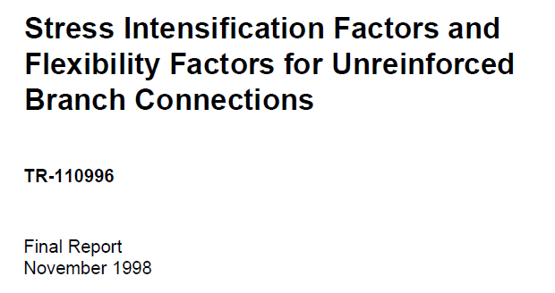
EPRI Finite Element Model
1) Same boundary conditions as Markl
2) Pipe lengths = 2D
3) Flat, faceted, 4-noded finite elements
4) Stresses used at (1/2)T from penetration line

Slide 46
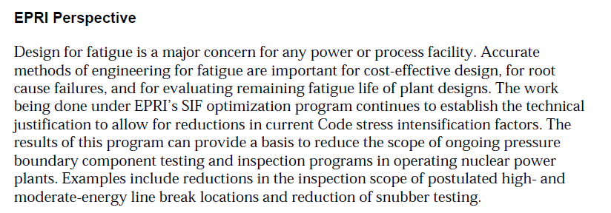

Slide 47
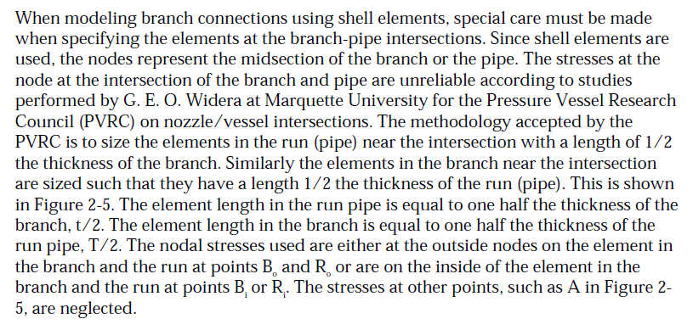
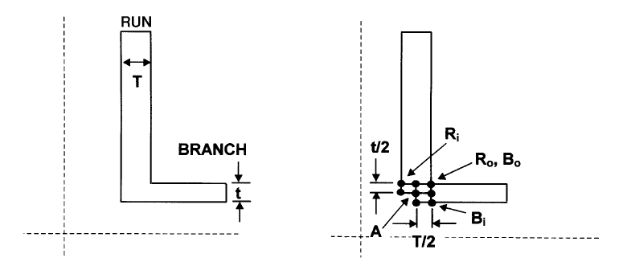

Slide 48
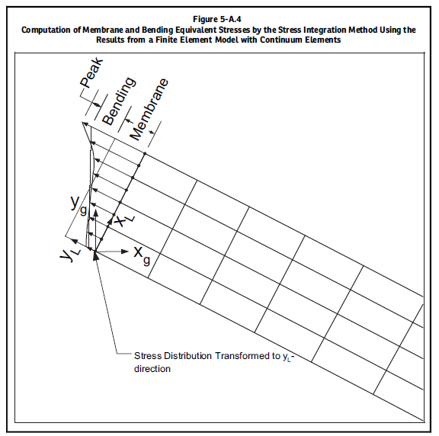

Slide 49
