Slide 1
EXPANSION JOINTS WITH CAESAR II
Dan Edgar
Senior-Flexonics, Pathway Div

Slide 2
CAU2014
PIPING ANALYSIS & EXPANSION JOINTS
Detail Modeling
Automated Modeling
Quick & Dirty Modeling
Common Errors

Slide 3
CAU2014 DETAILED MODEL
DETAIL EXPANSION JOINT MODELLING
° Bellows
° Hardware
° Restraints

Slide 4
CAU2014 DETAILED MODEL
EXPANSION JOINT MODELLING
° Bellows
° Hardware
° Restraints

Slide 5
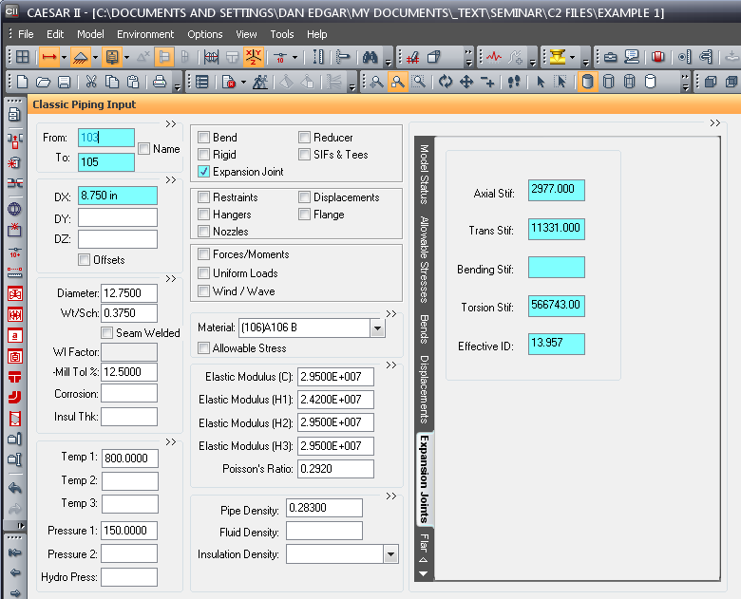
CAU2014 DETAILED MODEL
TYPE OF BELLOWS INPUT
Long - Input length &
omit angular S/R.
Short - Leave length
blank and input all
values

Slide 6
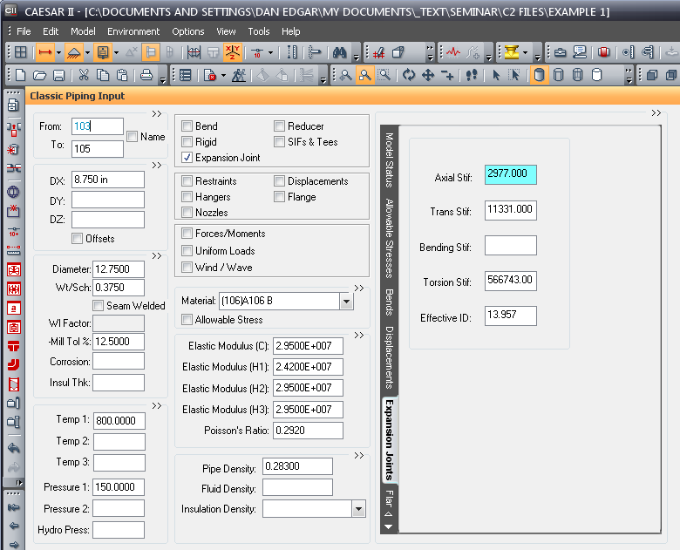
CAU2014 DETAILED MODEL
AXIAL INPUT

Slide 7
CAU2014 DETAILED MODEL
LATERAL INPUT

Slide 8
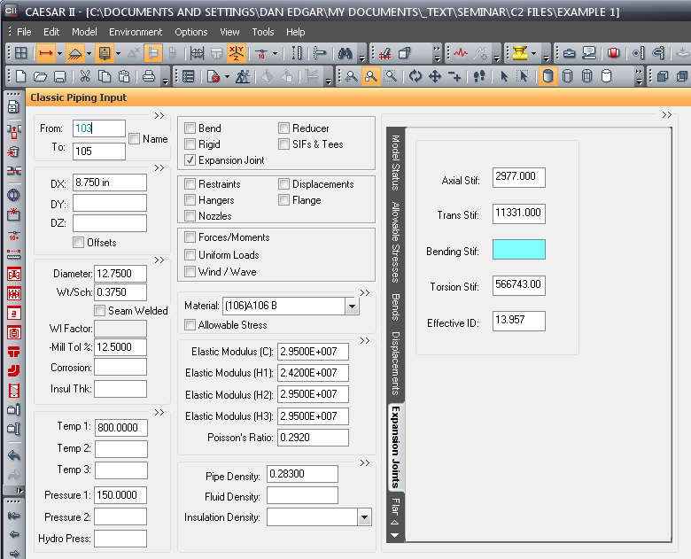
CAU2014 DETAILED MODEL
ANGULAR INPUT

Slide 9
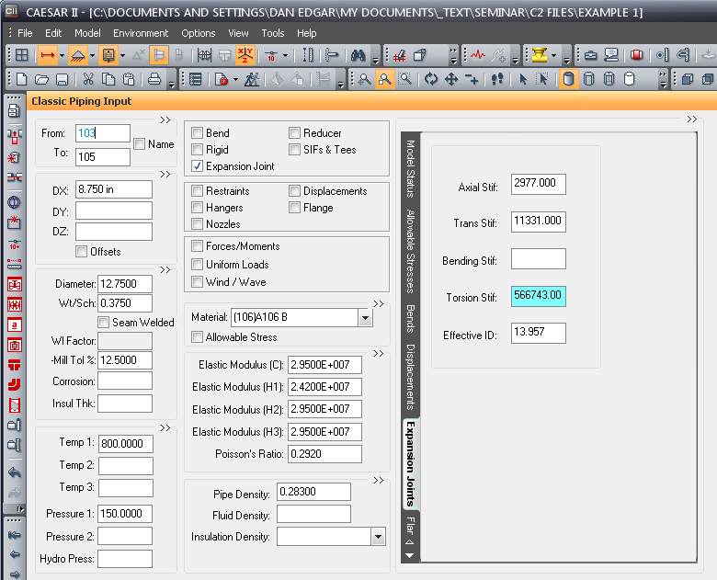
CAU2014 DETAILED MODEL
TORSIONAL INPUT

Slide 10
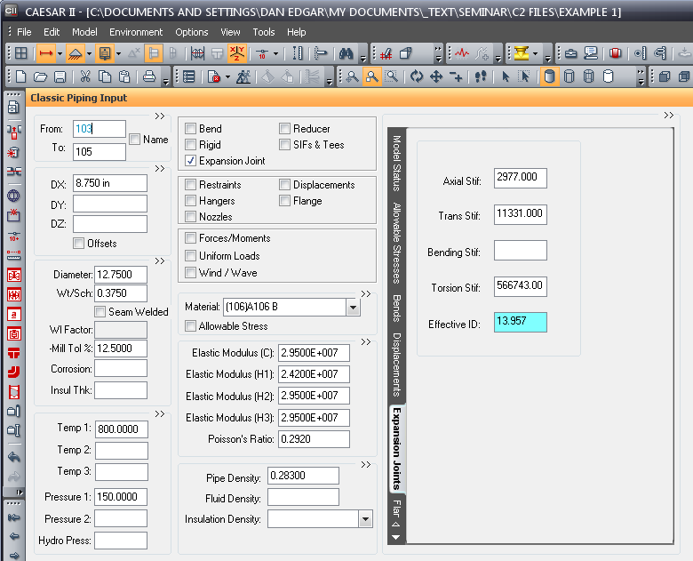
CAU2014 DETAILED MODEL
Effective ID
Effective ID = (A_{f} ∙ 4 / π )^{1/2}
A_{f} = Effective Area

Slide 11
CAU2014 DETAILED MODEL
EXPANSION JOINT MODELLING
° Bellows
° Hardware
° Restraints

Slide 12
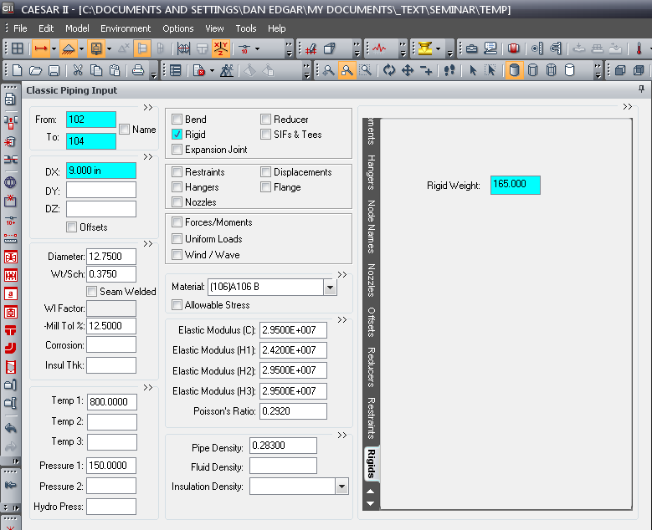
CAU2014 DETAILED MODEL
HARDWARE - Input 1/4 of joint weight for each end of the expansion joint

Slide 13
CAU2014 DETAILED MODEL
° Bellows
° Hardware
° Restraints

Slide 14
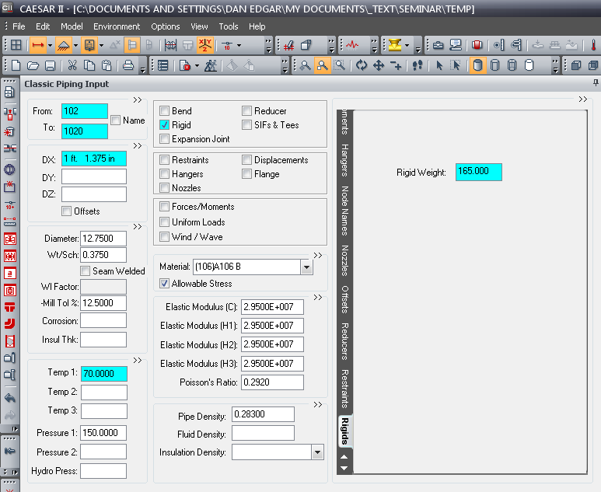
CAU2014 DETAILED MODEL
RESTRANTS - Model rigid elements and then connect with restraints
Rigid Element
Restraint

Slide 15
CAU2014 DETAILED MODEL
TIED RESTRANTS - Tie Rods modeled as a rigid & one end restrained by Cnodes

Slide 16
CAU2014 DETAILED MODEL
HINGE RESTRANTS - Arms joined at centerline and then restrained by Cnodes

Slide 17
CAU2014 DETAILED MODEL
GIMBAL RESTRANTS - Arms joined at centerline and then restrained by Cnodes

Slide 18
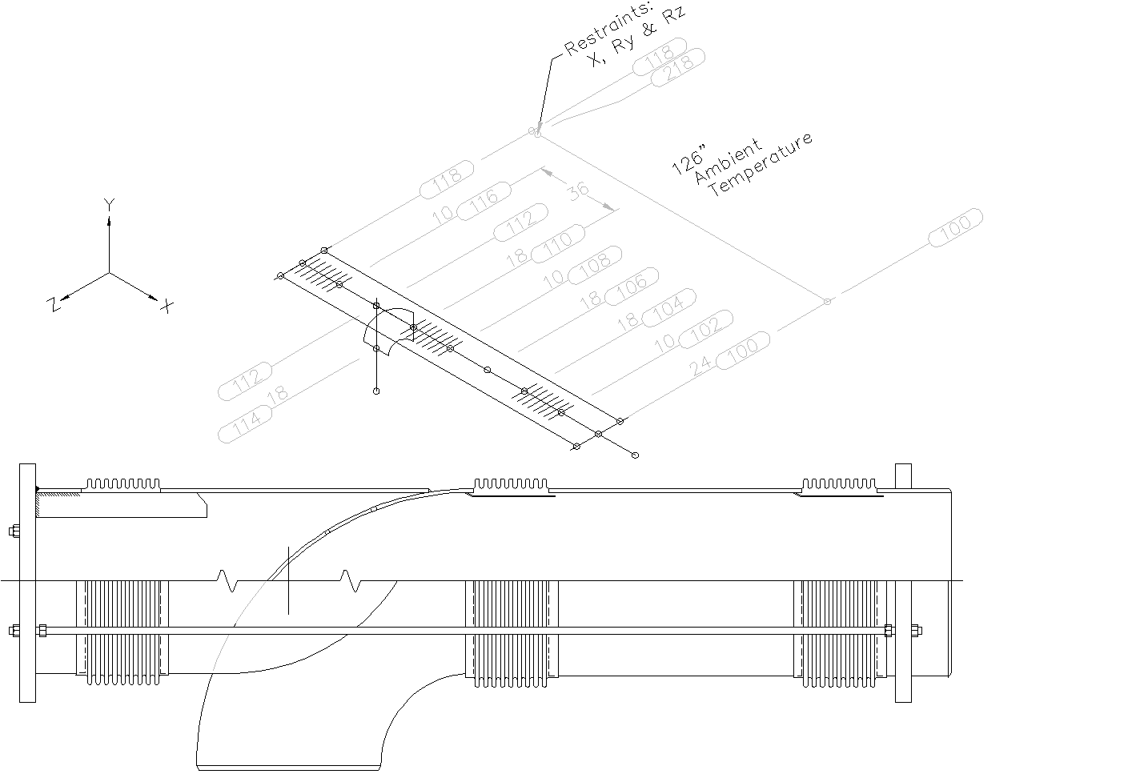
CAU2014 DETAILED MODEL
Pressure Balanced Elbow / Tee

Slide 19
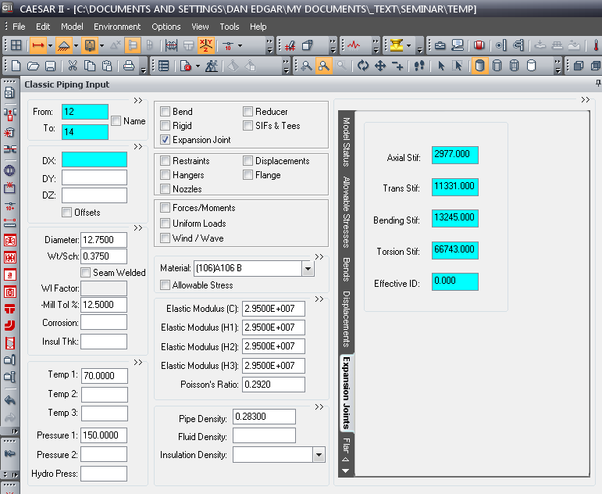
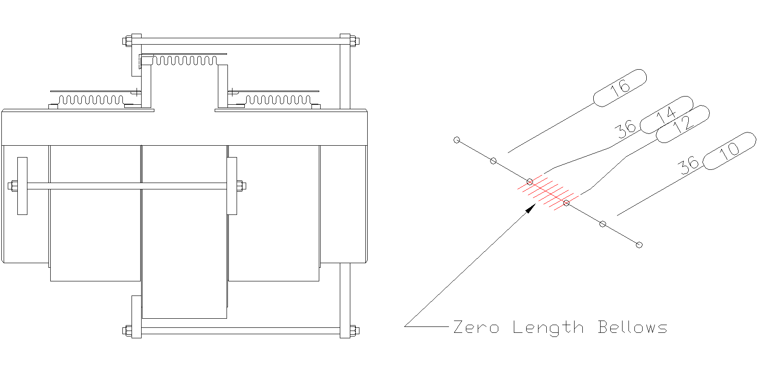
CAU2014 DETAILED MODEL
Inline Pressure Balanced

Slide 20
CAU2014 AUTOMATED MODEL
AUTOMATED EXPANSION JOINT MODELING (EXPANSION JOINT DATABASE)

Slide 21
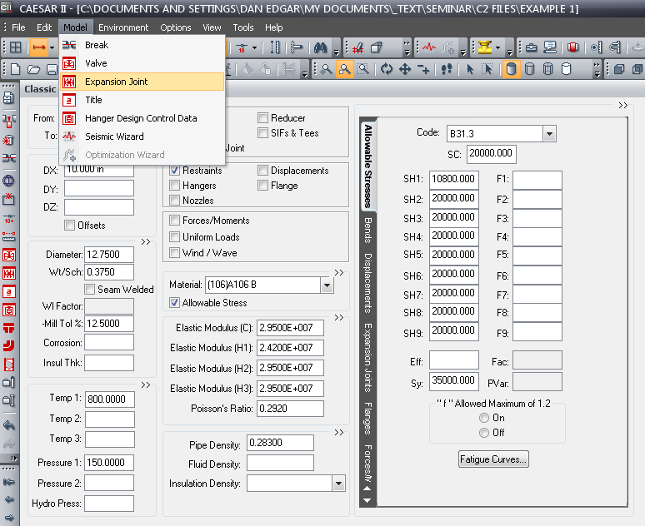
CAU2014 AUTOMATED MODEL

Slide 22
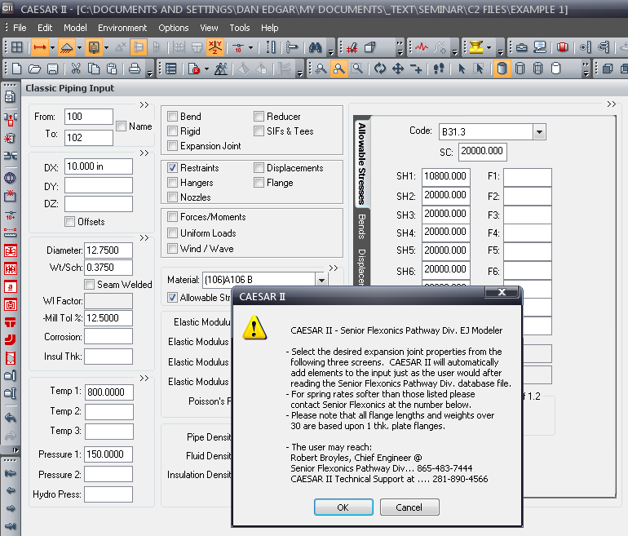
CAU2014 AUTOMATED MODEL

Slide 23
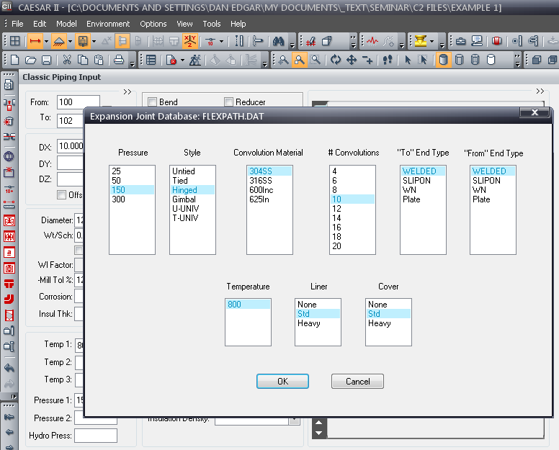
CAU2014 AUTOMATED MODEL

Slide 24
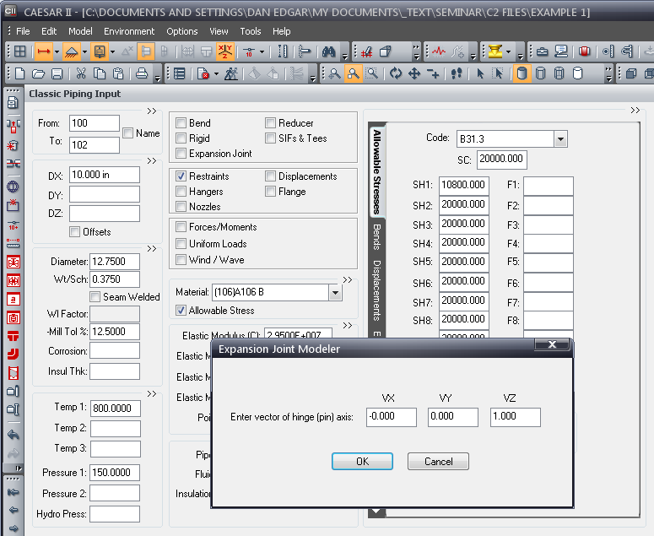
CAU2014 AUTOMATED MODEL

Slide 25
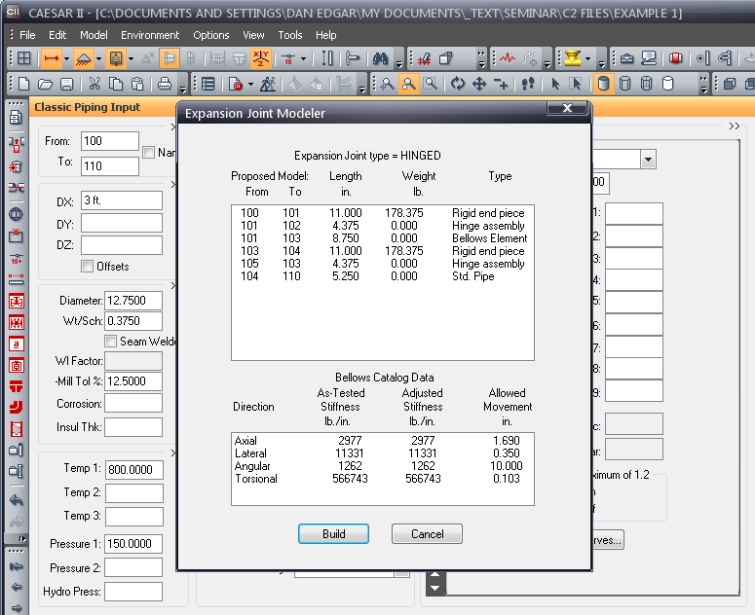
CAU2014 AUTOMATED MODEL

Slide 26
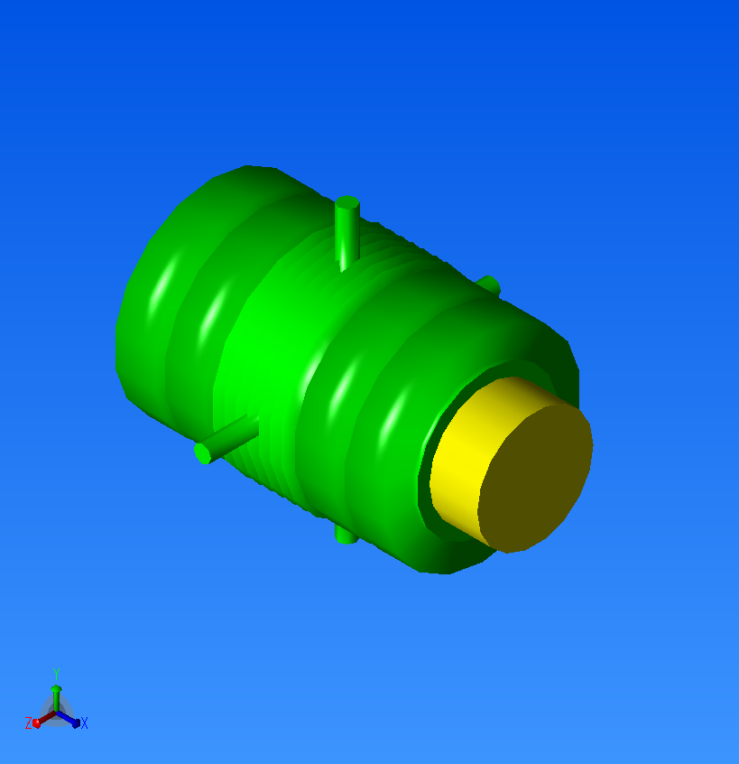
CAU2014 AUTOMATED MODEL

Slide 27
CAU2014 QUICK & DIRTY
QUICK & DIRTY EXPANSION JOINT MODELING (Tricking the computer)

Slide 28
CAU2014 QUICK & DIRTY
Manipulating line input to model an expansion joints
° Use zero length bellows
° Include weight & length in adjacent rigid elements
° Use an infinitely large (10e6) spring rate to model a restraint

Slide 29
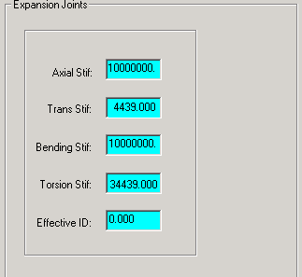
CAU2014 QUICK & DIRTY
TIED Expansion Joint:
Spring Rates:
Axial…………………. 10e6
Lateral ………………. Actual
Angular ……………… 10e6
Torsional ……………. Actual
Effective ID …………. 0
Inlet/Outlet - Ambient temperature rigid elements with 1/2 the weight of the unit

Slide 30
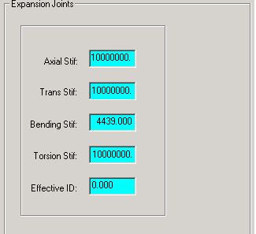
CAU2014 QUICK & DIRTY
HINGED Expansion Joint:
Spring Rates:
Axial…………………. 10e6
Lateral ………………. 10e6
Angular ……………… Actual
Torsional ……………. 10e6
Effective ID …………. 0
° Inlet/Outlet - Ambient temperature rigid elements with 1/2 the weight of the unit.
° Restraint in axis perpendicular to pins

Slide 31
CAU2014 QUICK & DIRTY
GIMBAL Expansion Joint:
Spring Rates:
Axial…………………. 10e6
Lateral ………………. 10e6
Angular ……………… Actual
Torsional ……………. 10e6
Effective ID …………. 0
° Inlet/Outlet - Ambient temperature rigid elements with 1/2 the weight of the unit.

Slide 32
CAU2014 TYPICAL PROBLEMS
ERRORS & OMISSIONS
°Large Rotation Errors
°Relative Rigidity Errors
°Pressure Thrust Errors

Slide 33
CAU2014 TYPICAL PROBLEMS
Large Rotation Errors

Slide 34
CAU2014 TYPICAL PROBLEMS
Large Rotation Errors

Slide 35
CAU2014 TYPICAL PROBLEMS
Large Rotation Errors

Slide 36
CAU2014 TYPICAL PROBLEMS
Large Rotation Errors

Slide 37
CAU2014 TYPICAL PROBLEMS
Large Rotation Errors

Slide 38
CAU2014 TYPICAL PROBLEMS
Relative Rigidity Errors

Slide 39
CAU2014 TYPICAL PROBLEMS
Pressure Thrust Errors

Slide 40
CAU2014 TYPICAL PROBLEMS
Pressure Thrust Errors

Slide 41
CAU2014 TYPICAL PROBLEMS
Pressure Thrust Errors

Slide 42
CAU2014 Errors & Omissions
Hinge Friction

Slide 43
CAU2014 Errors & Omissions
Hinge Friction
M_{f} = ½ • F_{f} • D_{p} = ½ • u • P_{t} • D_{p}
Or
F = M_{f} / ( ½ • L) = u • P_{t} • D_{p} / L
Where
M_{f} = Frictional moment in the plain of motion, in•lb
F = Frictional force at the bellows tangent, lbs
F_{f} = Frictional force at the pin surface, lbs = u • P_{t}
D_{b} = Pin Diameter, in
P_{t} = Expansion joint pressure thrust, lbs
u = Coefficient of friction, either static or sliding. Sliding frictional values:
Steel on Steel 0.74
Case Hardened with dry lubricant 0.30
Lubricated steel 0.10

Slide 44
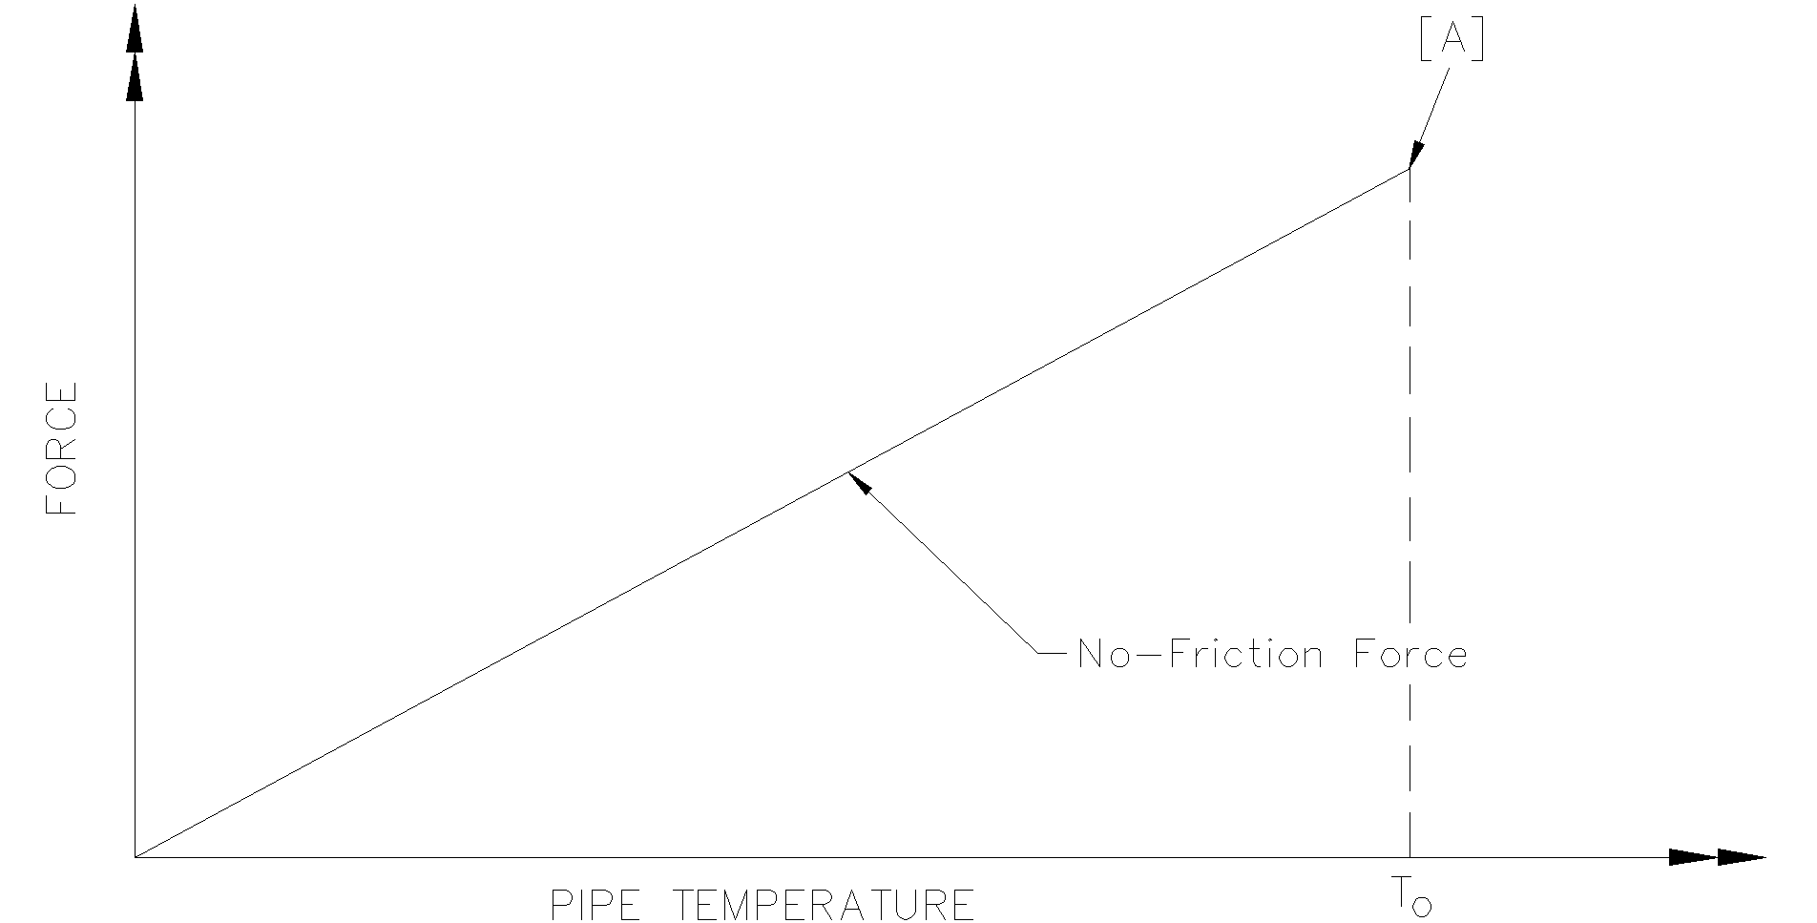
CAU2014 Errors & Omissions
Hinge Friction

Slide 45
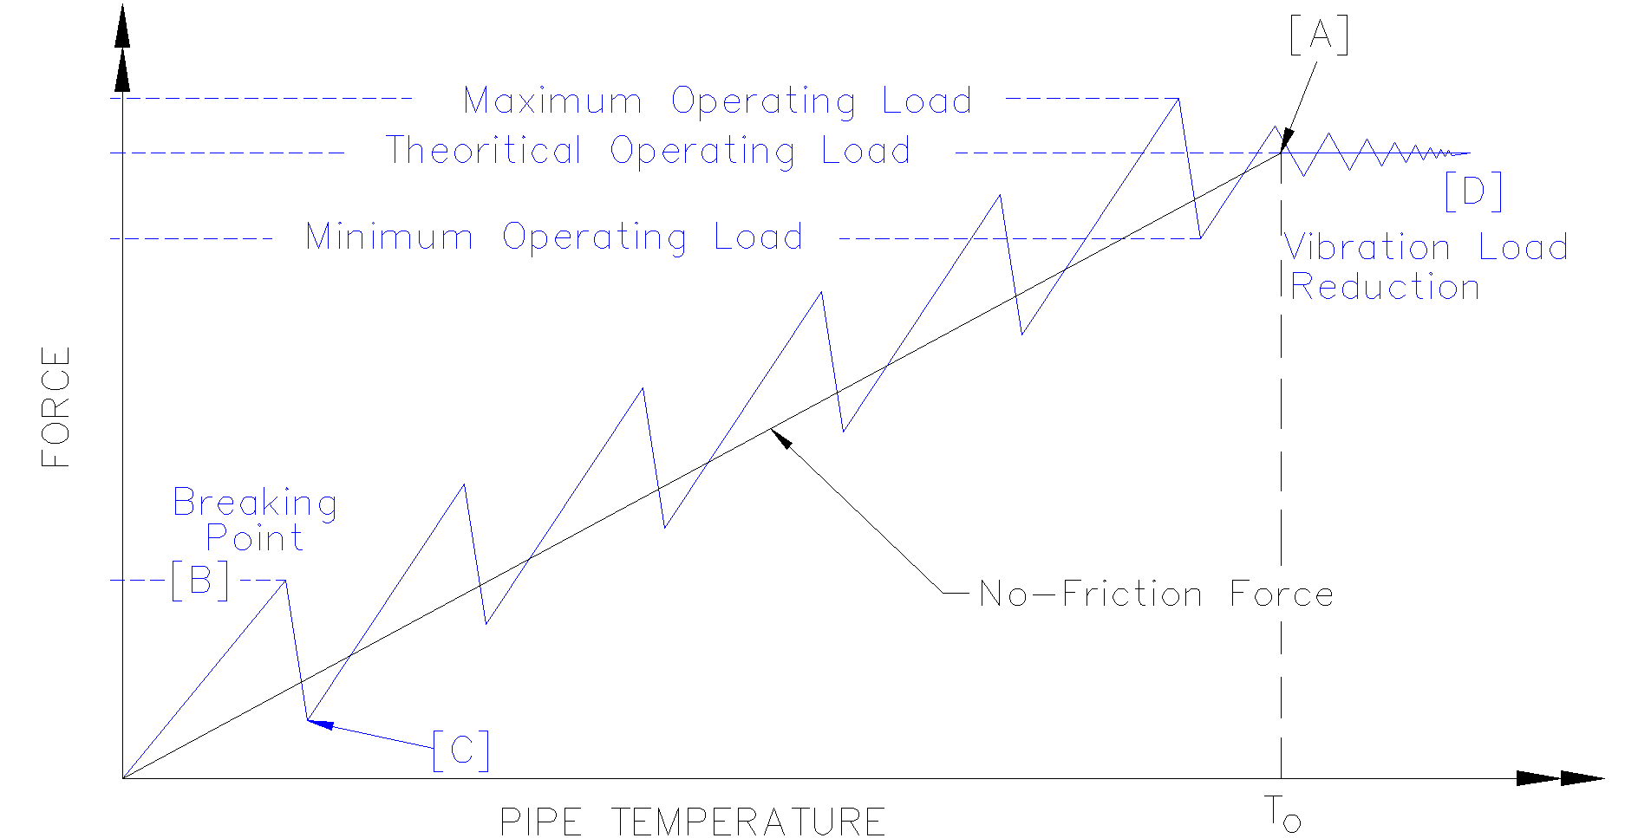
CAU2014 Errors & Omissions
Hinge Friction

