Slide 1
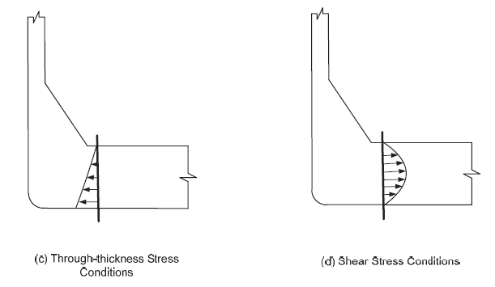

Slide 2
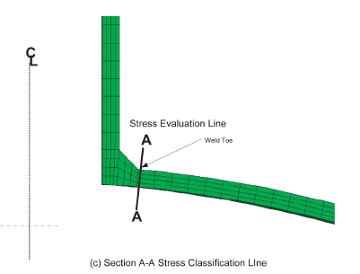

Slide 3
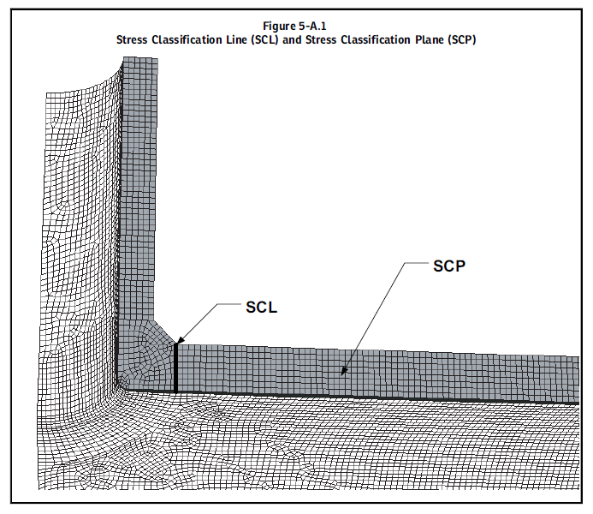

Slide 4
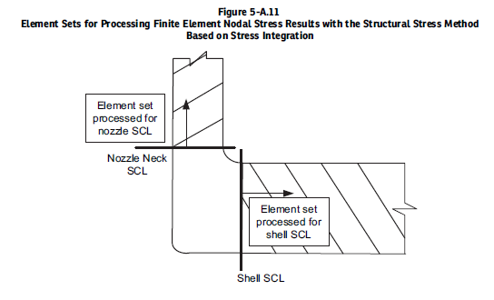

Slide 5
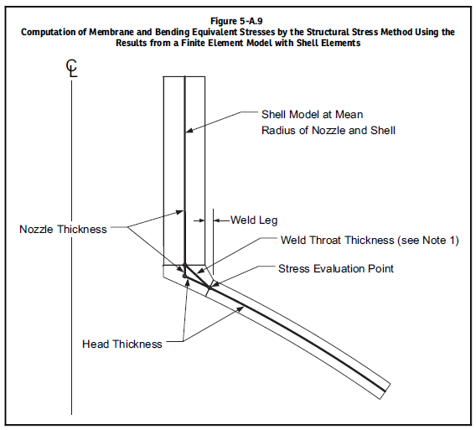
Replicate bending inertia and area at junction if possible.

Slide 6
Finite Element SIF Development Guidelines for Welded Geometries
1) If using shells for local bending stress problems (branch connections), and flat, faceted four-noded elements, and 1/2T clearence elements from the penetration line with no consideration of the weld size, then use SCF = K₂ = 1.0.
2) If using shells for local bending stress problems, curved, 8-noded elements, and approximating 1/2T clearence from penetration line with no consideration of the weld size, then use SCF = K₂ = 1.0.
3) If using shells for local bending stress problems and curved, 8-noded elements, and includeding tapered elements for the weld zones as described in VIII-2 Part 5 Annex 5.A, then use SCF = 1.3 to 1.6. Shells should replicate area and inertia of penetration line ring.
4) If using bricks for local bending stress problems, and including weld models with stress classification lines at the toes of the fillets, then use SCF = 1.3 to 1.6. Brick elements of various types can be used to estimate the number of cycles of a nominal load to cause thru wall cracks to exist. J Integrals and crack growth calculations can be used although to produce accurate results, often more than one crack must be simulated.

Slide 7

Can almost all SIF data from the literature be used equally?
No
SIF test data is only valid when the girth butt weld curve used for comparison is adequately valid. Remember:
Tests conducted and reported in 2007 by Chris Hinnant (then at PRG), now at K&H Fabricators in Smithville Texas are shown on the following slide:

Slide 8
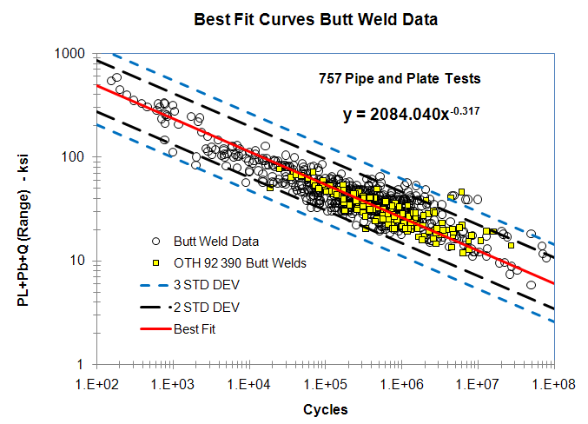

Slide 9
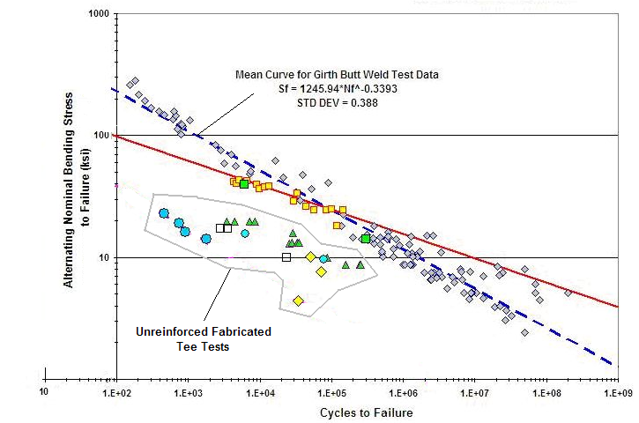
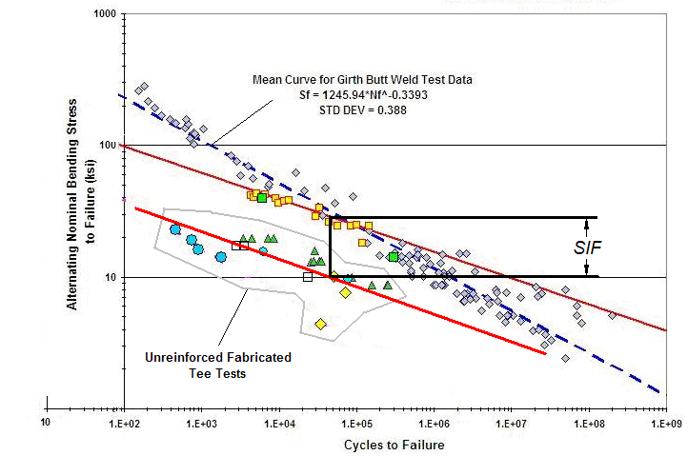

Slide 10
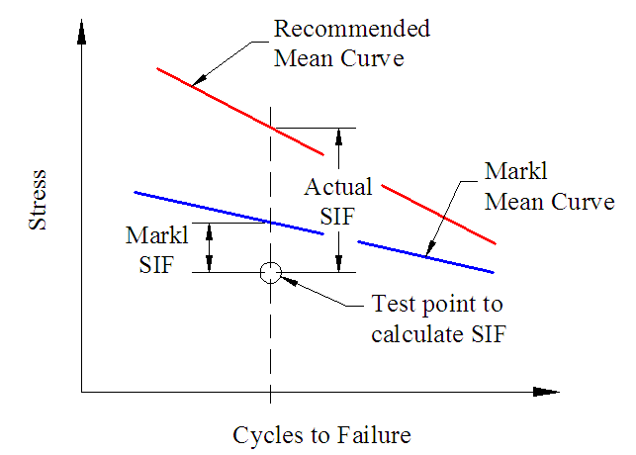

Slide 11
Be careful with SIFs developed over a very short cycle range. If possible get values at low and high cycles. SIFs for cycles < 5000 involve plastic behavior in crack formation and growth.

Slide 12
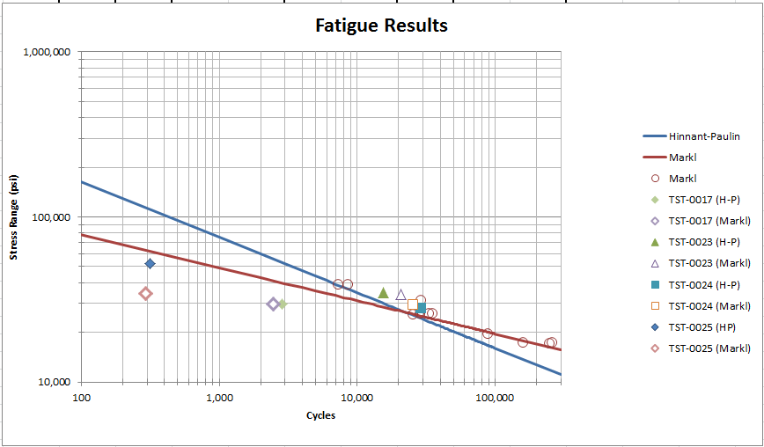
4” Std. Wall Unreinforced Fabricated Tee (Sketch 2.3) [1950-2013]

Slide 13
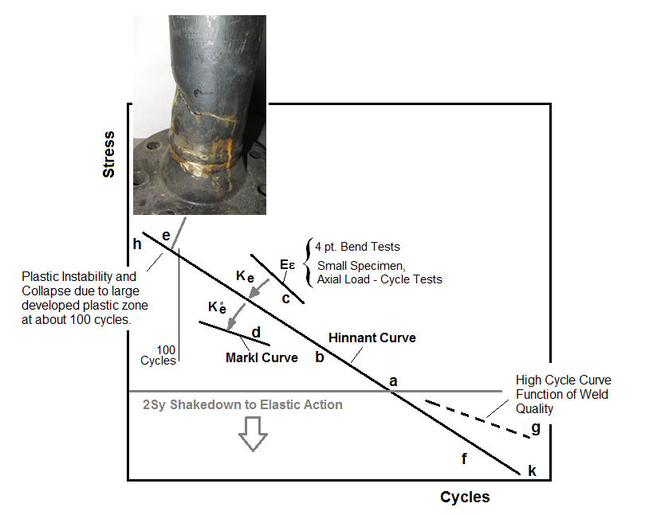
Notes:
We’ll define four regions of a piping applicable fatigue curve and see if we can explain some of the confusion.
4pt. Bend tests, ASME smooth bar, and Hinnant E-epsilon – here. Hinnant here. Markl here <point to the curves>
In the low cycle end tey converge at point “a” In the low end side there’s too much plasticity and we collapse. The high end we’ll discuss later.
At the low end there’s a lot of things that can influence behavior. Do the Code rules keep us out of that range?

Slide 14
When comparing SIFs to validate the finite element model you should recognize that there are at least three distinct regions in the cycle diagram where SIFs will vary from one to another, and that, as the cycle count gets smaller the different in the SIFs gets larger. You can also note that each of the methods converges at between 10,000 and 20,000 cycles, so the desire is to find SIF tests in that range and then to compare them to the finite element model. The alternative is to:
1)Use the twice yield method to compare strain from the finite element model to strain from a cantilever butt weld. Essentially plot Ke as a function of elastic displacement and compare it to either a cantilever test or the predicted result from a 4pt bend test. From this method, determine the girth butt weld curve that should be used with the SIF result in the low cycle range to predict the SIF.
2)Test data indicates that inplane fabricated tees follow the Markl curve for example, while out-of-plane fabricated tees tend to follow the Hinnant girth butt weld curve.

Slide 15
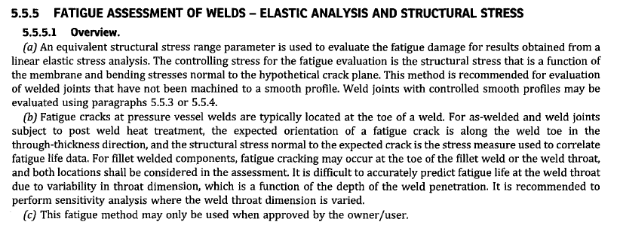
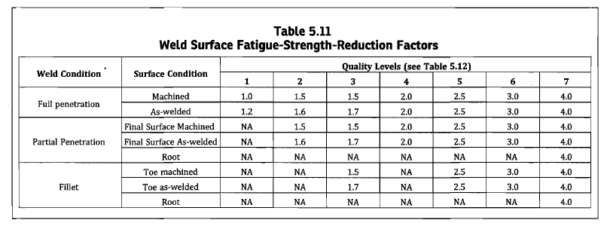

Slide 16
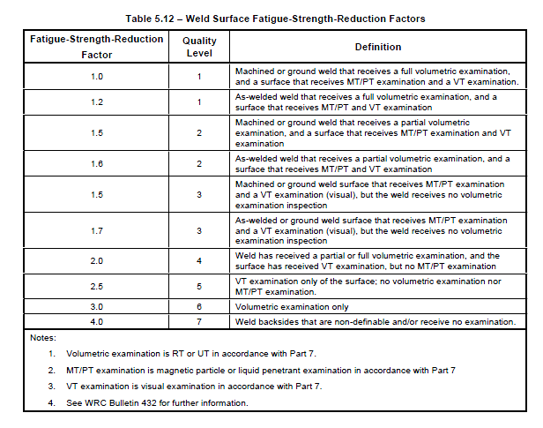
1.35
Notes:
What SCF (or FSRF) should be used? Since the 1990’s PRG has been using the value of 1.35 to envelope FEA results. Wais and Rodabaugh in EPRI 110996 recommend using a value of SCF = 1.0 and no fillet models for FEA with stresses computed at ½ T from the element penetration line.

Slide 17
Key Mean Stress to Failure Equations (psi, range)
PRG/Hinnant (welds) 1,895,000 N^{-0.3353}
;nominal M/Z stress range to failure (girth weld)
Markl (welds): 490,000 N^{-0.2}
;nominal M/Z stress amplitude to failure (girth weld)
ASME Welded Mean: 1,576,317 N^{-0.3195}
;nominal M/Z stress range to failure (VIII-2 Part 5)
;simplifications for all coeffiients. For information only.
Polished Bar: 2(8664N^{-0.5} + 21.6) x 1000
;smoothed bar stress range to failure
N = Cycle to failure
Notes:
Here are three welded approaches and the ASME polished bar curve that can be compared on an apples-to-apples basis for predicting failure – the first three for welded geometries, and the last for smooth surfaces.
These equations are used to: 1-predict cycles if doing a failure study, or to 2-find the degree of separation between design and mean failure prediction. Are we too conservative – or not conservative enough. Results may be interesting in the high’ish cycle ranges > 40,000 cycles or so.

Slide 18
Don’t expect accurate SIFs for certain geometries.
If you don’t know the geometry you can’t predict the SIF from a finite element calculation.
What are examples of this.

Slide 19
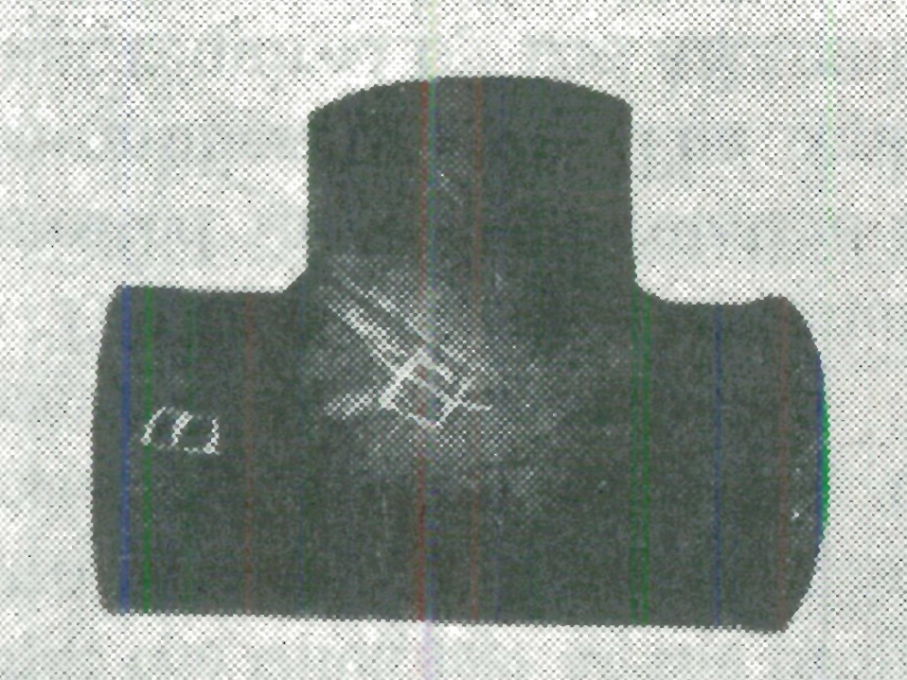
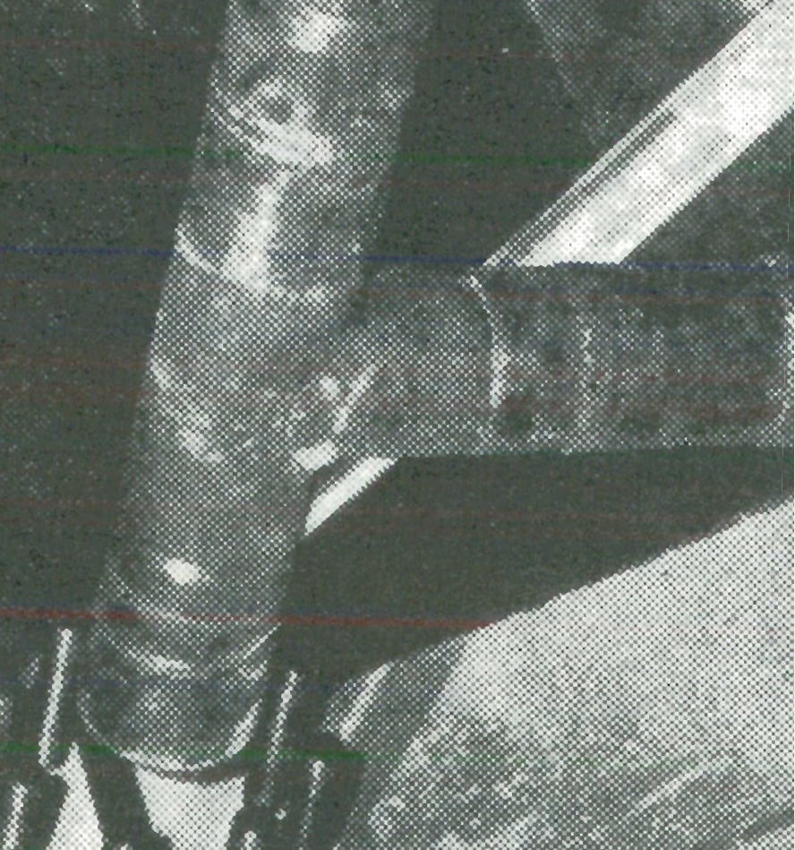
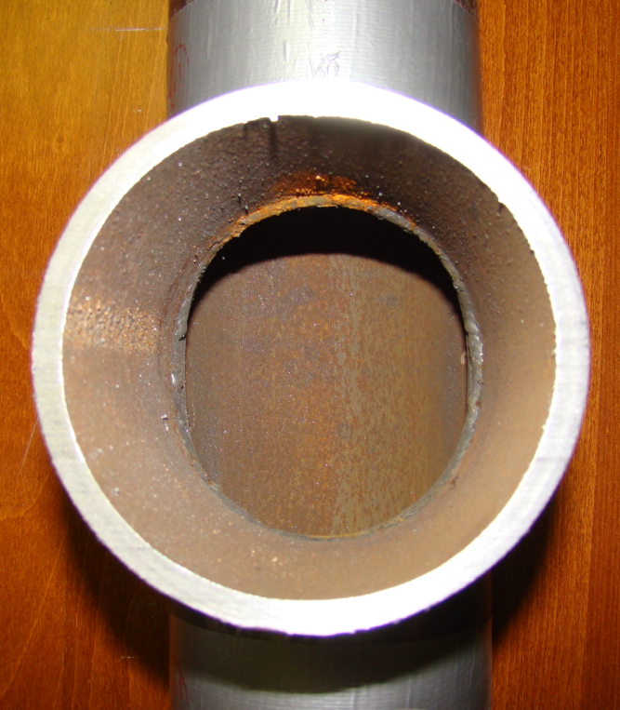
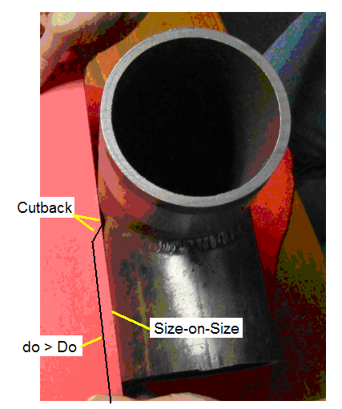
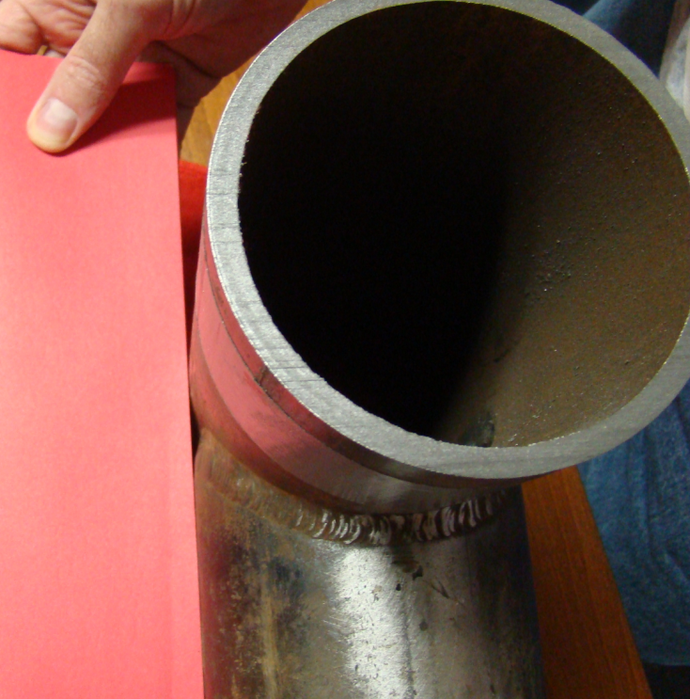

Slide 20
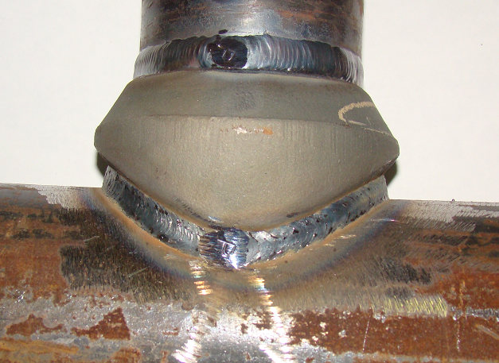
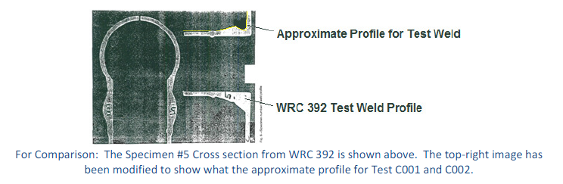

Slide 21
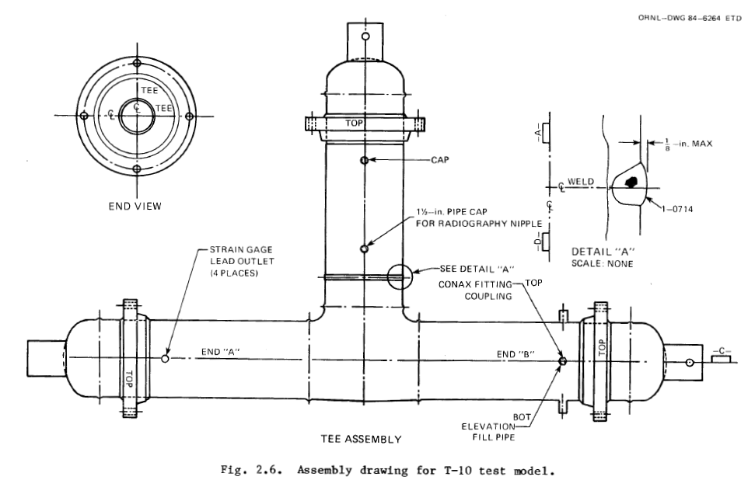
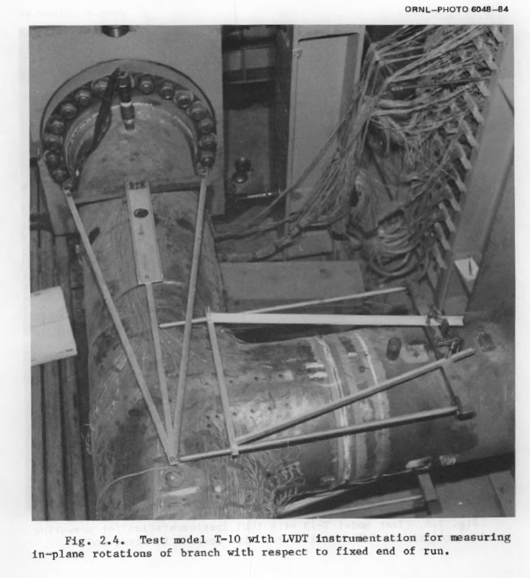
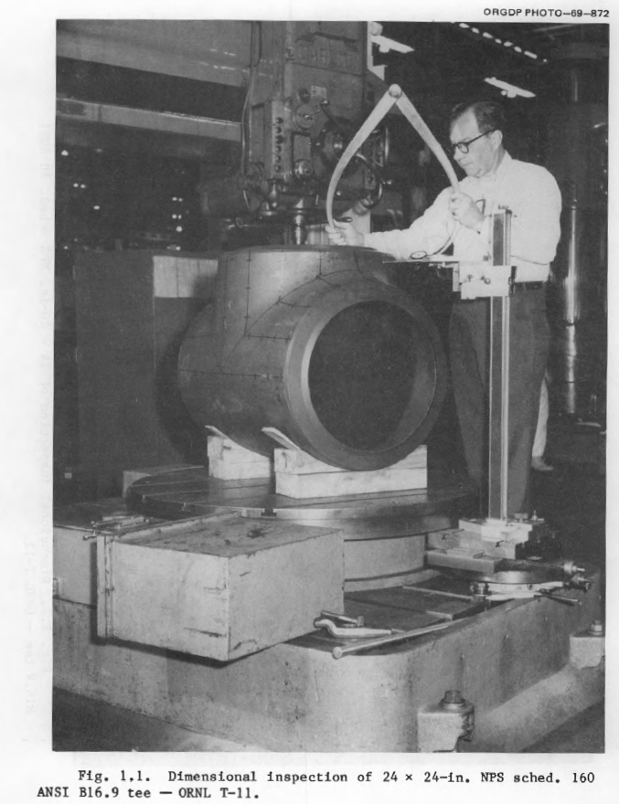
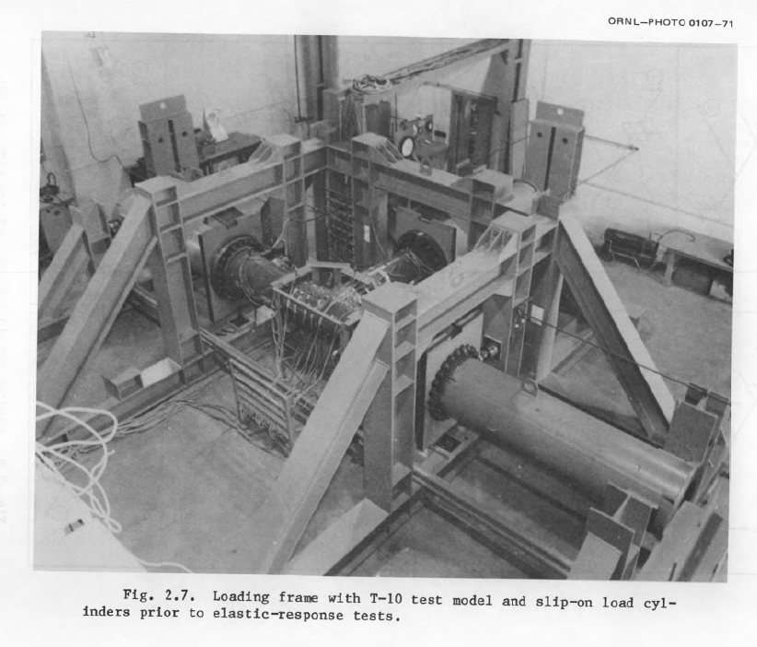

Slide 22
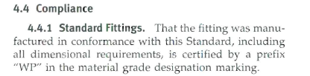
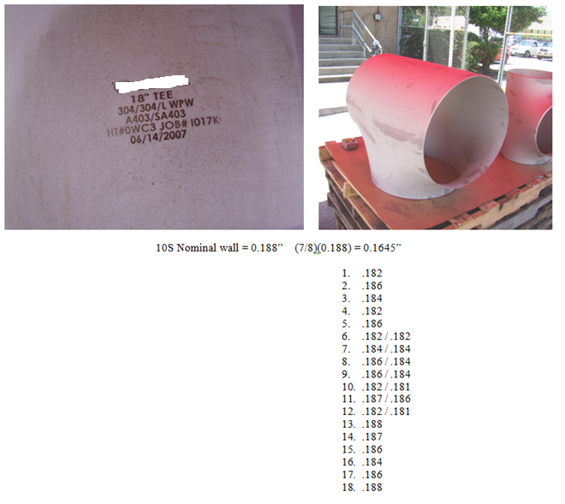
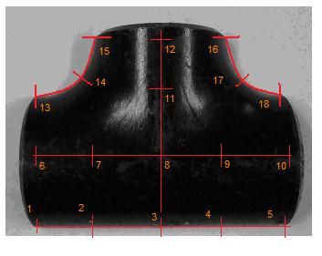
WPW-Welded
WPS-Seamless

Slide 23
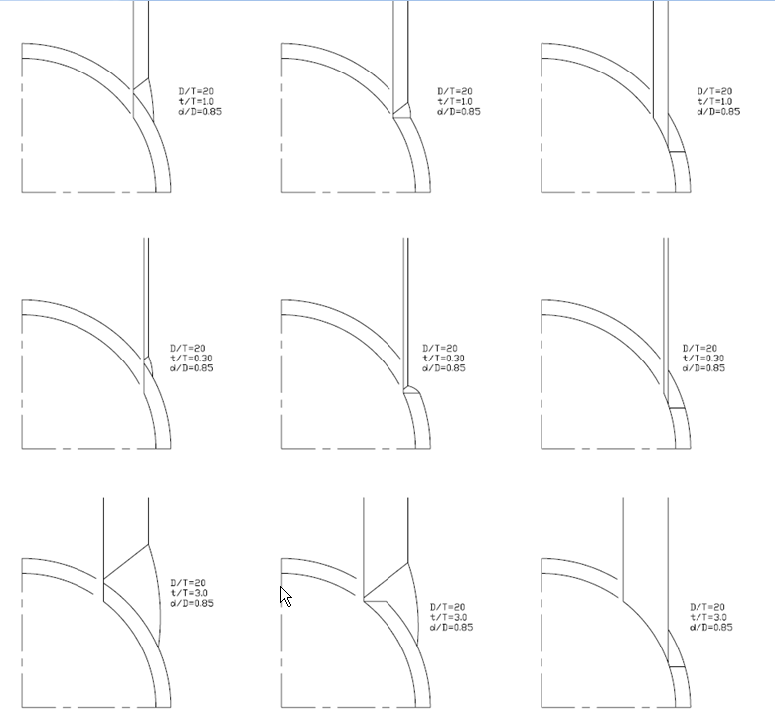
Notes:
Relatively simple equations must address a large variety of welded branch connections

Slide 24
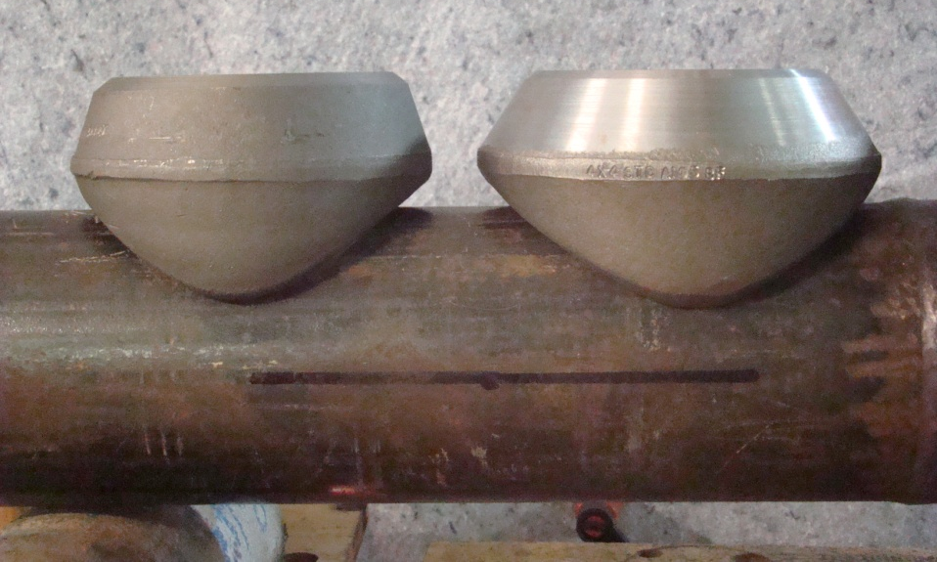
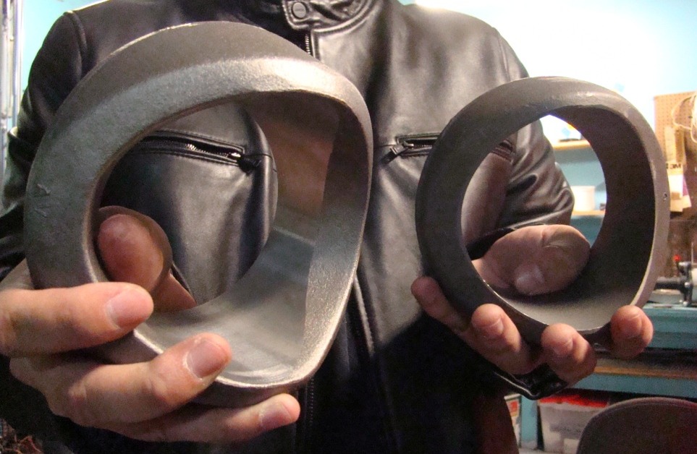
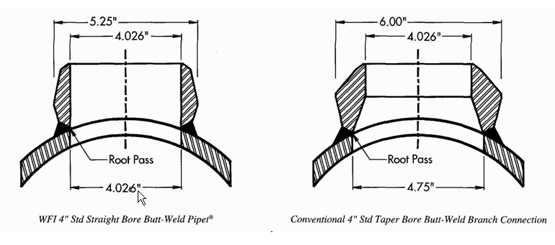
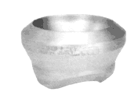
Notes:
Straight thru on the left and taper bored on the right

Slide 25
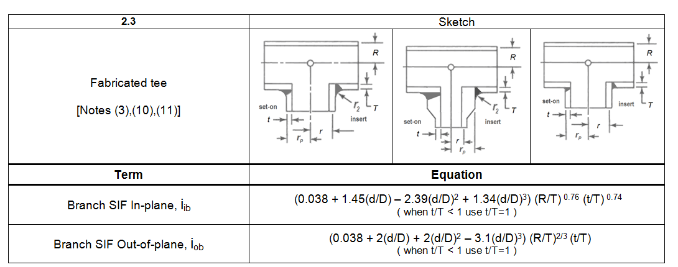
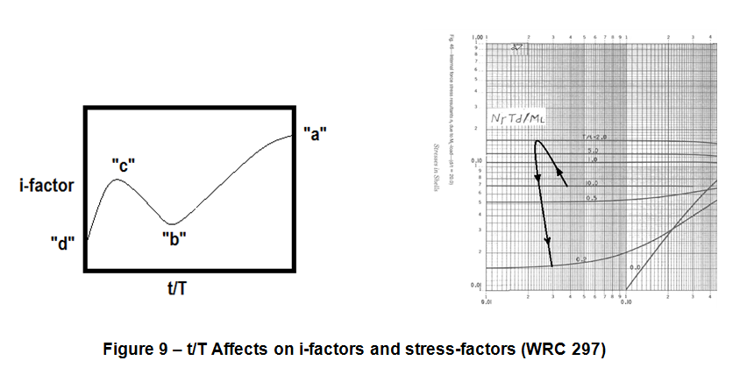

Slide 26
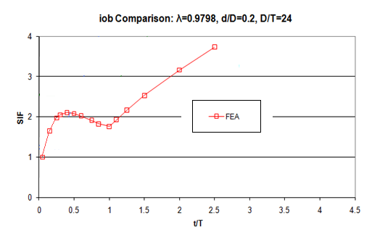
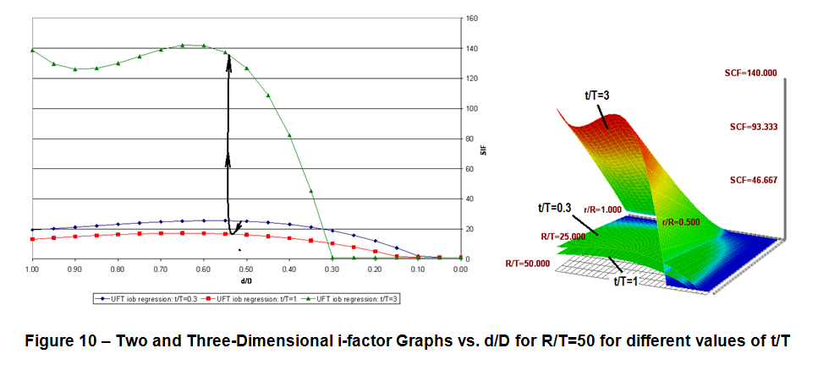

Slide 27
Conclusions:
SIFs in Low Cycle Range can be Off
Many SIFs are based on as-welded geometries.
For a lot of standard piping geometries we don’t have much data in the high cycle range at all.
For a lot of standard piping geometries we don’t have much geometry data at all.
For a lot of the tests, cracks appear, and then remain almost dormant until the end of life when they begin to grow more quickly. The SIF indicates the total time it takes from start of loading to thru-wall failure.
Singularities can exist in shell and brick solutions that will significantly impact SIF prediction. Results will be mesh dependent. At some point user must make consistent adjustment. (“For this mesh this is the right number to use.”)
Be careful using effective section modulus. When you put an i-factor on the branch of the tee know that the program might be multiplying by t/T “in the background.”

Slide 28
For certain geometry and frequency ranges there is not much data on which to base finite element results. To be useful, the finite element results must be compared against test data.
Don’t expect high SIF prediction accuracy for welded construction. Life is very much a function of the quality of the weld – so the SIF falls to the welders experience, the WPS, the condition of the equipment, the ability to position the part, and the weather.
When cycling is known to be greater than 3000 – for welded geometries, care with weld procedures and inspection (as reflected in VIII-2 Part 5) is important.
For high cycles (>20,000) tests on small specimens give higher life than tests on full size specimens.
FEA is very helpful for trends
If the t/T ratio is not 1.0 for a reduced branch connection the the i-factor based on the nominal stress is i(t/T). In ST-LLC 07-02 t/T is not permitted to go lower than 0.85.
For laterals – which are not in the code, the torsion SIF becomes the out-of-plane SIF, and the out-of-plane SIF moves toward the torsional SIF, but with a larger footprint for both.

Slide 29
No weld SIF = (Mem+Bend)/2/Snom
Weld included in model SIF = (Mem+Bend)xSCF / 2 / Snom: When the weld is included in the model, the M+B stresses will be alittle lower, and SCFs for models without welds should be increased.
Components where actual SIFs vary the most:
1)Size on Size fabricated tees
2)Extruded tees (based on observations in WRC 329)
3)Olets – although newer tests suggest that reducing olets can be made stronger – but not weaker with improved welding?
4)Pads – because the width is not included in the test, there isi very little data, and it is difficult to inspect – all prescriptions for poor performance.
If developing a SIF from a test, know which slope to use – i.e. Hinnant slope, or Markl slope for nominal stress in girth butt weld prediction.
Pick the nominal stress definition and adhere to it. Don’t use a SIF unless the nominal definition and section modulus is clear or obvious.

Slide 30
Be careful which pipig model used with thick fittings and where the SIFs are located in the model.
Pressure and axial load SIFs can introduce difficulties that are beyond the scope of this presentation. There are reasons they were not included in ST LLC 07-02. Pressure often cycles more than external loads. Section III uses pressure “SIFs” for Class 1 piping.
For volumetric (brick) models the SIF for welds is often based on the SCL M+B stress, and not an estimate peak at a weld. (Although peak stresses at welds are calculated by various approaches, i.e. weld modelling, hot-spot methods, etc.)
Be careful extrapolating SIFs – there are min and max values in the parameter ranges for branch connection geometries, e.g. a SIF from one test size may need to be extrapolated to other sizes, and the extrapolation is not always linear.

Slide 31
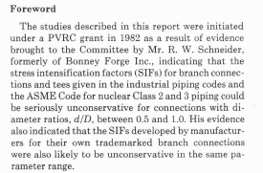
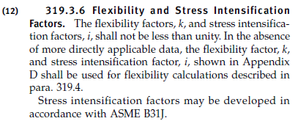
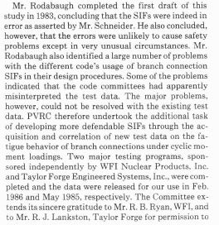

What is the definition of a SIF?
SIF = Stress Intensification Factor
Notes:
To get SIFs from FEA we need a reasonable definition of a SIF so that we know what we’re looking for.

Slide 32
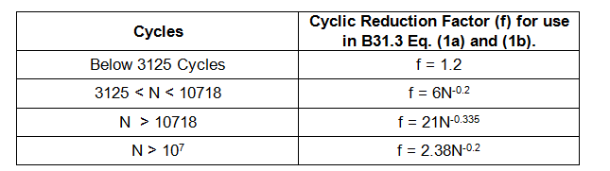
Notes:
What are our recommendation? Below 3125 cycles at the point where f=1.2 – limit f=1.2 – this is as per the code.
Up to 10718 use f = 6N-0.2 per Markl to cover any Ke geometry.
Above 10718 use the Hinnant slope.
Above 10^7 use a high cycle slope – where we recognize that high cycle life is strongly influenced by weld quality, shape, etc.

Slide 33
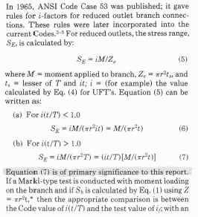


Slide 34
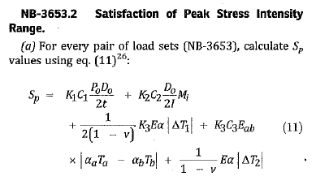
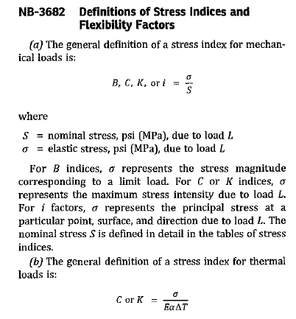
References from Section III are from the 2011 Addenda

Slide 35
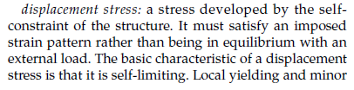
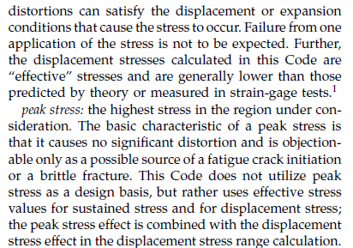
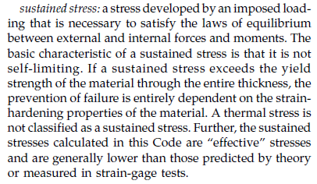
Where is pressure ?

Slide 36
SIF Definition Used Here
SIF is the ratio between the stress of interest (S’) and the nominal stress (Snom)
S’ = SIF x Snom
This definition was selected because:
a)Some codes use i-factors for sustained stresses
b)At some point we have to deal with reduced branch connections.
The reduced branch connection definition in the B31.1, B31.3 and NC/ND piping codes is:
S’ = SIF x (t/T) x Snom
Why don’t we see the t/T problem? Because most i-factor tests are done on size-on-size components and we don’t see the range of t/T and d/D fittings in fabricated tees to see the issue. For size on size t/T = 1.

Slide 37
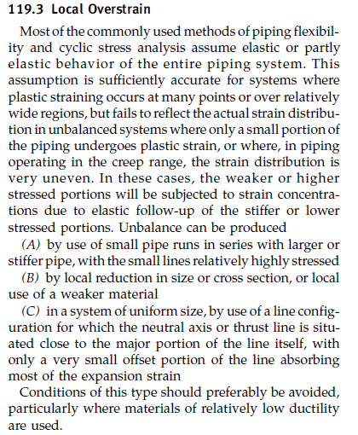
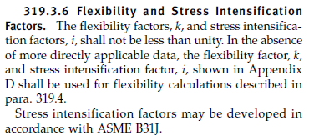
B31.1 Excerpts are from 2010 Version of B31.1: B31.1(119.3) vs. B31.3 (319.3)

Slide 38
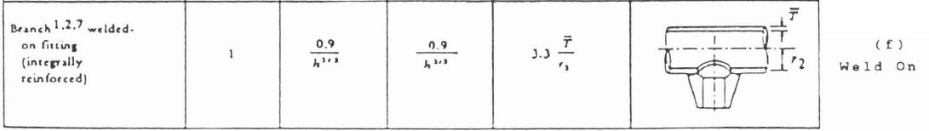

Excerpt from Table 1, p.4.
WRC 329 – pp.31,32.

Slide 39


Slide 40

The most common “not in Appendix D” problem:
D/T > 100
0.5 < d/D < 1.0 may be non-conservative.

Slide 41



Slide 42


i-factors for in-plane thru the run should be larger than i-factors for out-of-plane thru the run.
In-Plane thru Run
iir > ior

Slide 43


Notes:
Three+ years ago the ASME initiated project ST-LLC 07-02. The results of that project have been presented at the ASME Mechanical Design Committee, are in the public committee meeting minutes, and are being presented by Mr. Peter Vu in Arkansas on April 02 to the ASME Career Technical Conference.

Slide 44


Slide 46


“Intent of the Code”

