Slide 1
Leverage Design Optimizations and Processes with CADWorx 2015
Robert Wheat
President/Owner
3D CAD, Inc.

Slide 2
Product Gas Plants

Slide 3
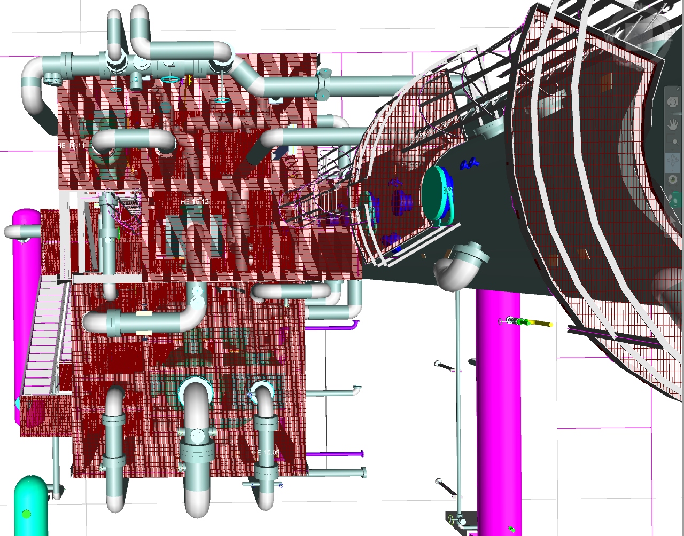
Product Cryogenic Units

Slide 4
Product Skids

Slide 5
Product Pipe Rack Systems

Slide 6
Leverage CADWorx 2015
Specifications
Spec/Size Change
Routing
I-Config
OrthoGen

Slide 7
Branch tables
Specification Editor showing branch tables
Pipe Support modeler is now included in the Specification Editor

Slide 8
Schedules, sizes, materials, etc.
Here schedules are easily changed across the entire specification
Sizes, materials, etc. are all as easy to change

Slide 9
Catalogs
Catalogs contains all the centralized data
There are no duplications of common needed data such as thread or socket engagements

Slide 10
Leverage CADWorx 2015
Specifications
Spec/Size Change
Routing
I-Config
OrthoGen

Slide 11
Spec/Size Change
Spec change adjusts the physical size of fittings also

Slide 12
Leverage CADWorx 2015
Specifications
Spec/Size Change
Routing
I-Config
OrthoGen

Slide 13
Routing
Allows horizontal & vertical dragging lines
Branch additions are easily added
Placing, moving, copying inline components are really easy
Component list dialog (as shown) is available

Slide 14
Leverage CADWorx 2015
Specifications
Spec/Size Change
Routing
I-Config
OrthoGen

Slide 15
I-Config
Unique find capabilities
Content sensitive help system
New organization and WYSIWYG

Slide 16
Template Drawing Editor
Use this drawing editor for locating drawing areas, BOM locations, etc.
Use for all the title block attribute locations
Utilize attributes for text populating from CSV line list file

Slide 17
Leverage CADWorx 2015
Specifications
Spec/Size Change
Routing
I-Config
OrthoGen

Slide 18
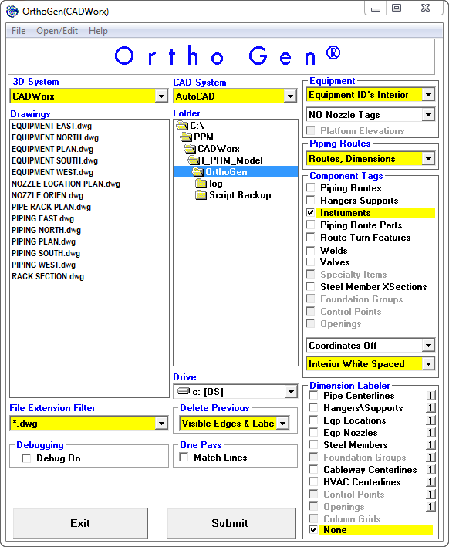
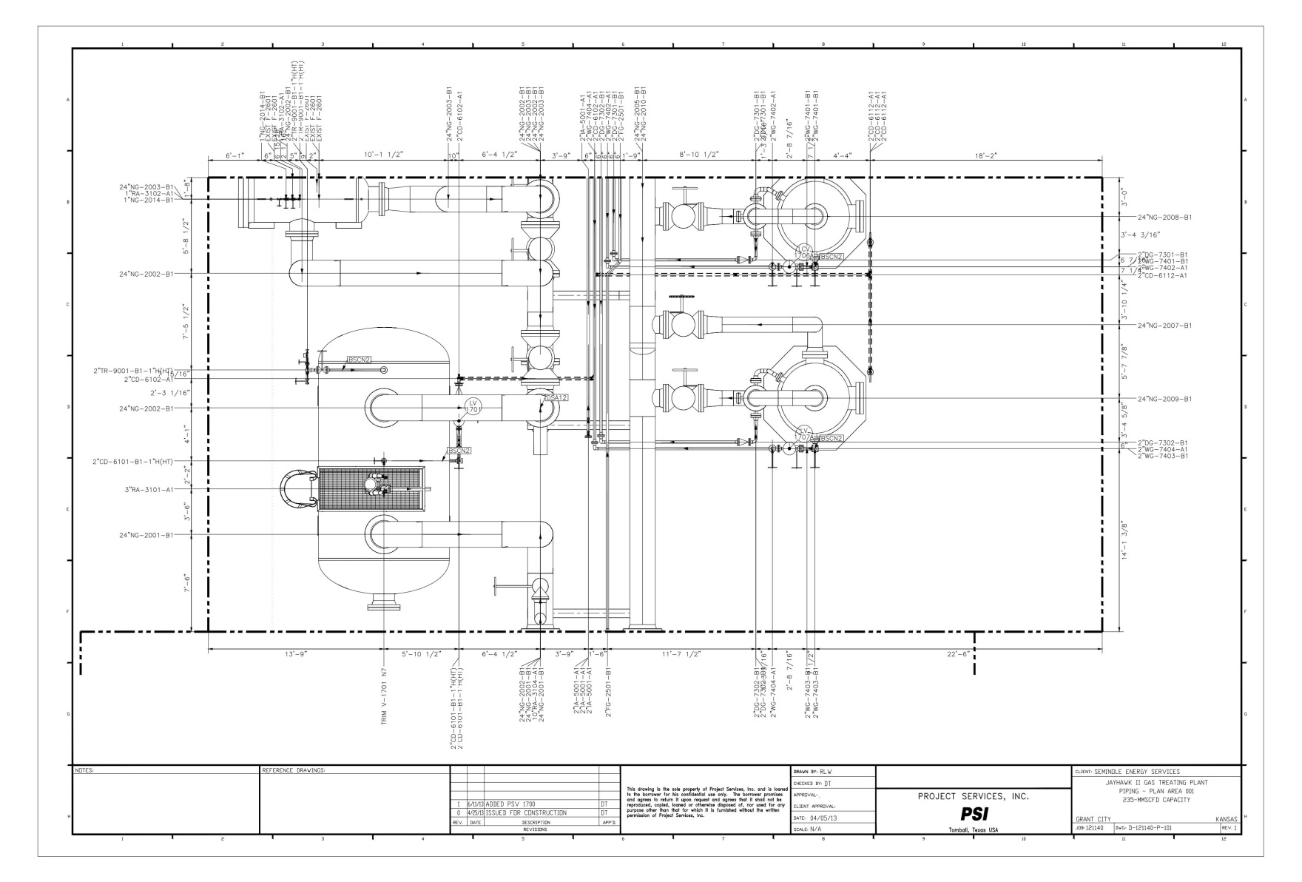
OrthoGen
Need slide here

Slide 19
Customer Requirements
Plot Plan
Model
Orthographics
Isometrics
BOMs

Slide 20
Layout Development
Model consist of large bore pipe, individual equipment models, and any other information that needs to be displayed at this scale
Utilize the CADWorx DIMCOORD command with the Centerline option for applying coordinates in paperspace
All other text and graphics all in paperspace

Slide 21
Site References
Complete MODEL_SITE is referenced into the plot plan.
Unused references are unloaded

Slide 22
Using Google Earth
First measure two points and note distance.
Print screen from Google earth along with displayed measured distance.
Insert in AutoCAD and scale using the Reference option of the SCALE command.

Slide 23
Customer Requirements
Plot Plan
Model
Orthographics
Isometrics
BOMs

Slide 24
Model
Complete model information is necessary if isometrics and orthographics are to be complete also
This model is also used for the design review

Slide 25
References
The piping model has referenced the site model which references all the equipment, buildings, foundations, etc.

Slide 26
Structural Model
This model could be referenced into the site model if desired
Definitely would be part of the piping model

Slide 27
Equipment Generation
We utilize a 0,0,0 base location for all equipment and then manipulate it in the model via the properties dialog (or quick properties dialog)
All equipment is XREF’ed into the site model on a locked layer

Slide 28
Equipment Generation (non CADWorx Equipment)
On non CADWorx generated equipment, CADWorx flanges, couplings, etc. will be used and given a line number such as
CAE-5000 COMPRESSOR$
NOZZLE A SUCTION
CADWorx has new functionality with the NOZZLEGENERICATTACH

Slide 29
Review
Getting a model reviewed is the hardest part of the job

Slide 30
Customer Requirements
Plot Plan
Model
Orthographics
Isometrics
BOMs

Slide 31
Model Plans
Typical MVIEW showing the model with text, dimensions, and graphics in paperspace
Underground specs are used to control dashed lines via plot configuration

Slide 32
Skid Layouts
Skid general arrangements

Slide 33
Single Line Steel
Generate single line steel with SLS

Slide 34
Steel detailing
Utilize CADWorx steel model to detail skids and such

Slide 35
Customer Requirements
Plot Plan
Model
Orthographics
Isometrics
BOMs

Slide 36
ISOGENBATCH
Models are batch iso’ed with the ISOGENBATCH command
100% has to batch
On occasion when only one will not batch, the ISOGENOUT command will be used reluctantly

Slide 37
Isometrics
Untouched isometrics

Slide 38
Customer Requirements
Plot Plan
Model
Orthographics
Isometrics
BOMs

Slide 39
LIVEDB
Utilize database to check by isolating specs and sizes via Access built in filters
This method is also good for checking various conditions, i.e. series of PIs or TIs

Slide 40
SYNC (In)
Change components in database and then import them back into the model environment

Slide 41
DBFGEN
This command allows generating a database without the use of the LIVEDB command

Slide 42
BOMEXTERNAL & BOMSETUP
Sort Order attribute order will aversely affect the validity of a exported BOM

Slide 43
Excel Output
Here output is based on the 2 column or spec
This output could be organized based on the line number

Slide 44
Command/Settings
Uncommon commands or setting mentioned in this presentation
DIMCOORD utilizing Centerline option
XCLIP (AutoCAD command)
UseObjectsFromXrefs (Setting dialog)
DELETEDATABASEIDCOUNTS
BOMEXTERNAL
SyncOnStartUp (Setting dialog)

Slide 45
Contact Information
Contact Information
Robert Wheat
wheat.robert@gmail.com

Slide 46
Questions
Questions

